Slide 1
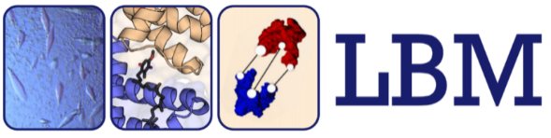



Modern tools to model proteins biomolecules even without templates in the PDB
AlphaFold 2, 3, etc.
Luciano A. Abriata
http://labriataphd.altervista.org/ https://go.epfl.ch/structbiol2025 → Links & more
Notes:
Hello I’m LA from MDP’s lab at EPFL in Switzerland. I’m here to go through a quick recap of the results of CASP13 in the track for tertiary structure prediction of hard targets, and then to discuss some ideas for the future of this track of CASP

Slide 2
Seminario sobre CASP, AlphaFold, etc en IBR:
https://www.youtube.com/watch?v=ebxXWdR4NhY (Oct. 2021)
Clase de modelado en el context de un curso sobre proteinas de membrana:
https://www.youtube.com/watch?v=Dp59c1RGyg8

Slide 3
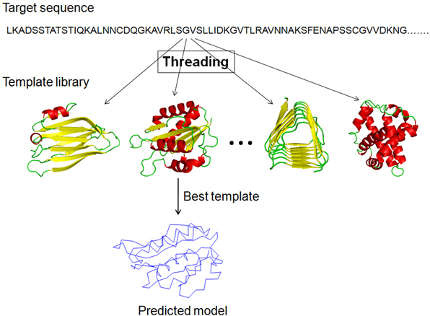
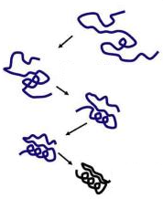
Modeling proteins of unknown structure
Homology modeling
Template-less prediction
Template detection
CASP
Critical Assessment of Structure Prediction
Dedicated issues in Proteins: Structure, Function and Bioinformatics
Threading
Physics- or Data- based conformational potential
Sampling capacity
Scoring to detect folded structure
External data? (experiments, coevolution, etc.)
Finding structurally similar template in PDB
Correctly aligning sequences
Threading
http://labriataphd.altervista.org/

Slide 4
Our online web app facilitates assessment and easily opens up results
http://predictioncenter.org/casp13/casp13-topology-assessment/
New structures CASP organizers Assessors
Predictors
My involvement in CASP…
Assessor: CASP12 and 13 (see Proteins 2018 and 2019)
Structure contributor in CASP15 (Proteins 2023)
Practical, overarching review in CASP16 (in revision)
CASP en español: Química Viva 17 (1) 2018
Notes:
So what we do in CASP is to evaluate all models for each EU. This evaluation is mainly visual but guided by scores, and we group very similar models into clusters. One contribution from our group to CASP is a web app that we can use to easily navigate models and compare them to the targets in a single interface. Moreover, once the evaluation is done we can open this to the world such that then when you read our paper you can follow each thing we describe directly here online. Let me show you quickly how this works… T0955D1

Slide 5
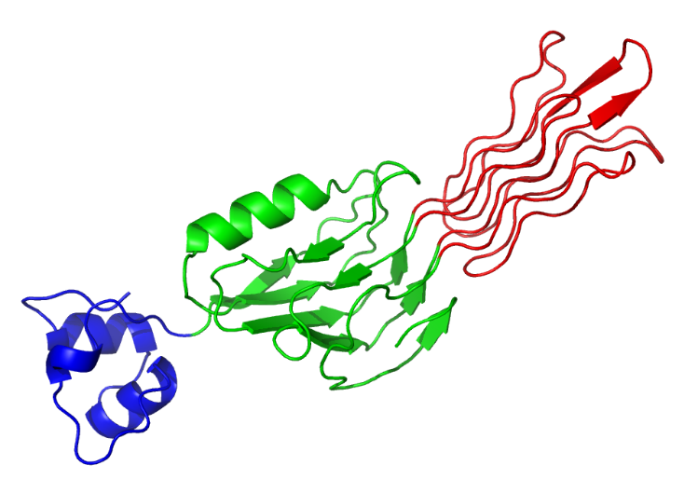
T0892-D1
T0892-D1
T0894-D2
T0890-D1
T0907-D1
T0876-D1
T0868-D1
T0909-D1
T0894-D2
T0907-D2
T0945-D1
T0890-D1
T0876-D1
T0907-D1
Average GDTTS of top 20 servers
T0912-D2
T0945-D1
T0907-D2
Average GDTTS of top 20 servers
T0943-D1
T0909-D1
T0901-D1
T0943-D1
T0868-D1
T0896-D2
T0912-D2
T0901-D1
T0874-D1
T0898-D2
T0884-D1
T0896-D2
T0875-D1
T0875-D1
T0887-D1
T0896-D1
T0887-D1
T0898-D2
T0874-D1
T0896-D1
T0884-D1
CASP targets have domains of varying difficulty
Easily findable templates for homology modeling
Intermediate situation
No good templates for homology modeling
Average GDTTS of top 20 servers
(HHpred score + LGA score) / 2
http://labriataphd.altervista.org/
Kinch et al Proteins 2019

Slide 6
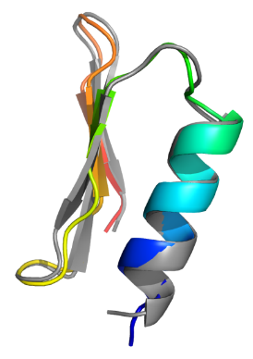
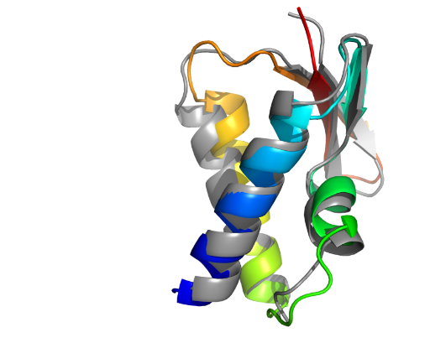
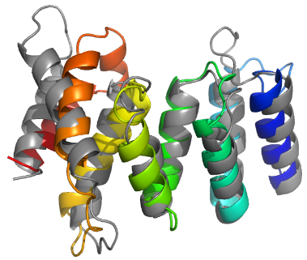
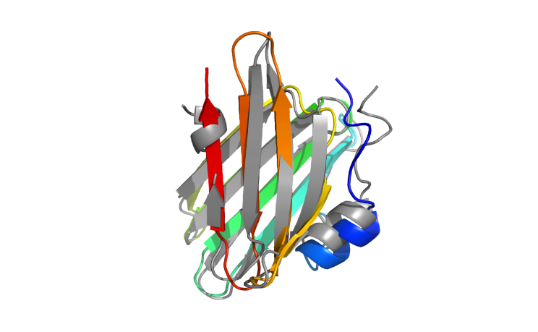
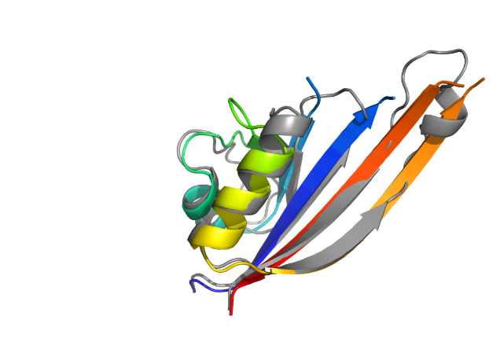
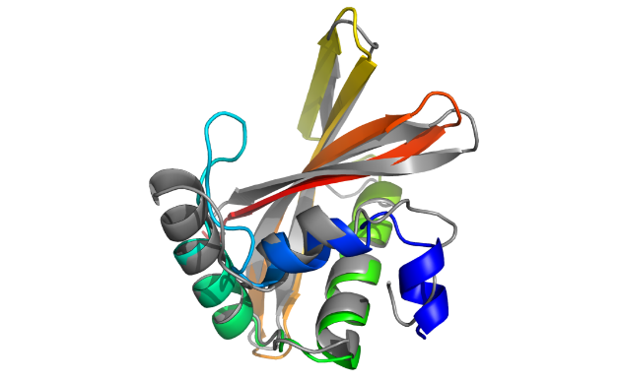
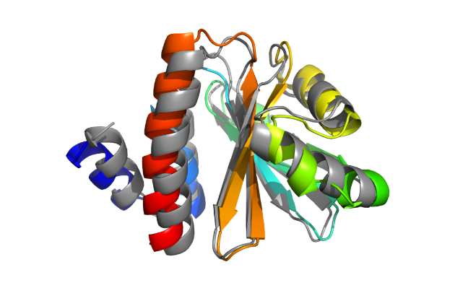
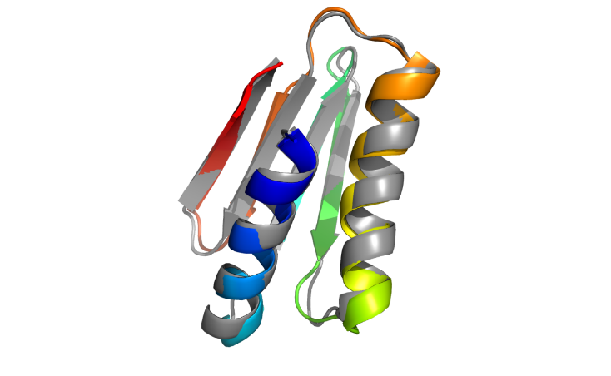
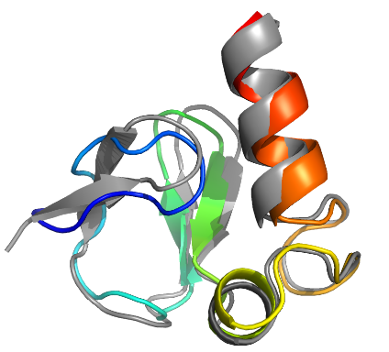
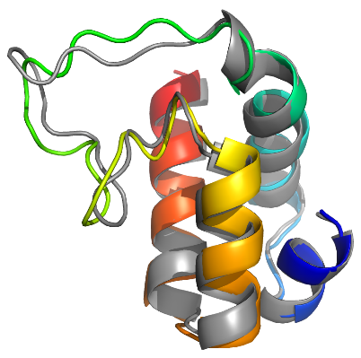
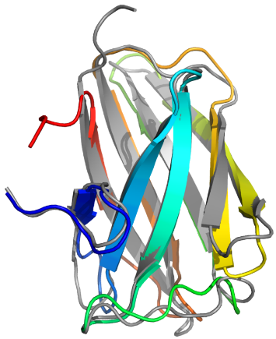
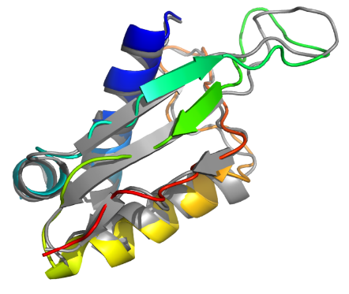
T0955-D1 (FM/TBM)
41 residues
T0957s2-D1 (FM)
154 residues
T0958-D1 (FM/TBM)
77 residues
TS441_2-D1 (219 models)
TS043_5
& TS043_1
TS431_1-D1 (32 models)
0.98 Å over full sequence
< 2.3 Å over 85% of the sequence
1.73 Å over full sequence
HHscore 19.46
LGA 93.4
Neff/L HHblits 0.02
HHscore 10.7
LGA 51
Neff/L HHblits 0.17
HHscore 48
LGA 69
Neff/L HHblits 0.39
T0968s1-D1 (FM)
118 residues
T0968s2-D1 (FM)
115 residues
T0970-D1 (FM/TBM)
96 residues
TS222_3-D1 (48 models)
TS043_1-D1 (12 models)
TS043_2-D1
(5 models plus 4 from TS347)
2.81 Å over full sequence
2.33 Å over full sequence
2.78 Å over 89% of sequence
HHscore 4.2 !
LGA 48
Neff/L HHblits 0.42
HHscore 19
LGA 50
Neff/L HHblits 1.23
HHscore 17
LGA 67
Neff/L HHblits 1.61
T1001 (FM)
139 residues
T1008 (FM/TBM)
77 residues
T1019s1-D1 (FM/TBM)
58 residues
TS222_4-D1 (106 models)
TS281_1-D1 (126 models)
TS043_2-D1 (85 models)
2.32 Å over full sequence
1.14 Å over full sequence
1.7 Å over full sequence
HHscore 11
LGA 55
Neff/L HHblits 0.04
HHscore 61
LGA 74
Neff/L HHblits 0.01
HHscore 48
LGA 54
Neff/L HHblits 10.26
T1021s3-D2 (FM)
101 residues
T0990-D1 (FM)
76 residues
T0992-D1 (FM/TBM)
107 residues
TS043_3-D2
(3 models)
TS274_2-D1 (118 models)
TS274_2-D1 (118 models)
1.65 Å over 95% of the sequence
1.6 Å over 95% of sequence
1.6 Å over 95% of sequence
HHscore 3.6
LGA 55
Neff/L HHblits 0.47
HHscore 2.4 !
LGA 56
Neff/L HHblits 0.51
HHscore 2.6 !
LGA 75
Neff/L HHblits 0.68

Slide 7
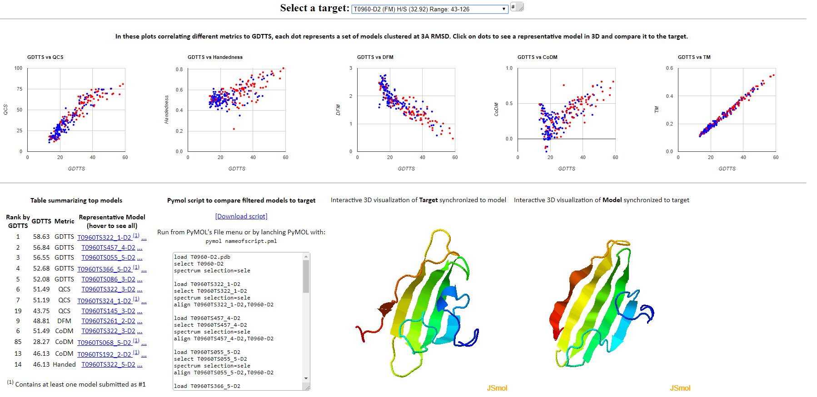
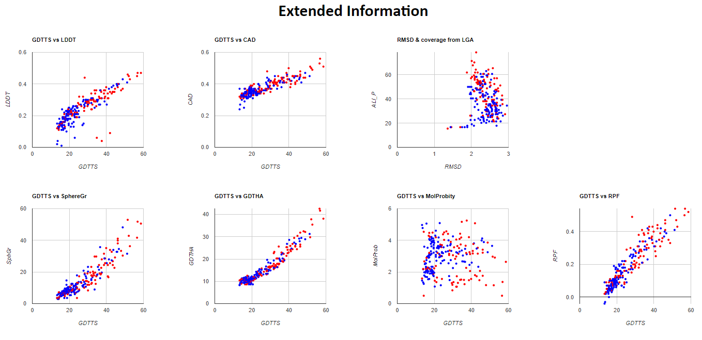
Our online web app facilitates assessment and easily opens up results
http://predictioncenter.org/casp13/casp13-topology-assessment/
Abriata, Tamo, Dal Peraro, Proteins 2019 (official CASP13 assessment)
https://onlinelibrary.wiley.com/doi/10.1002/prot.25787
Notes:
So what we do in CASP is to evaluate all models for each EU. This evaluation is mainly visual but guided by scores, and we group very similar models into clusters. One contribution from our group to CASP is a web app that we can use to easily navigate models and compare them to the targets in a single interface. Moreover, once the evaluation is done we can open this to the world such that then when you read our paper you can follow each thing we describe directly here online. Let me show you quickly how this works… T0955D1

Slide 8
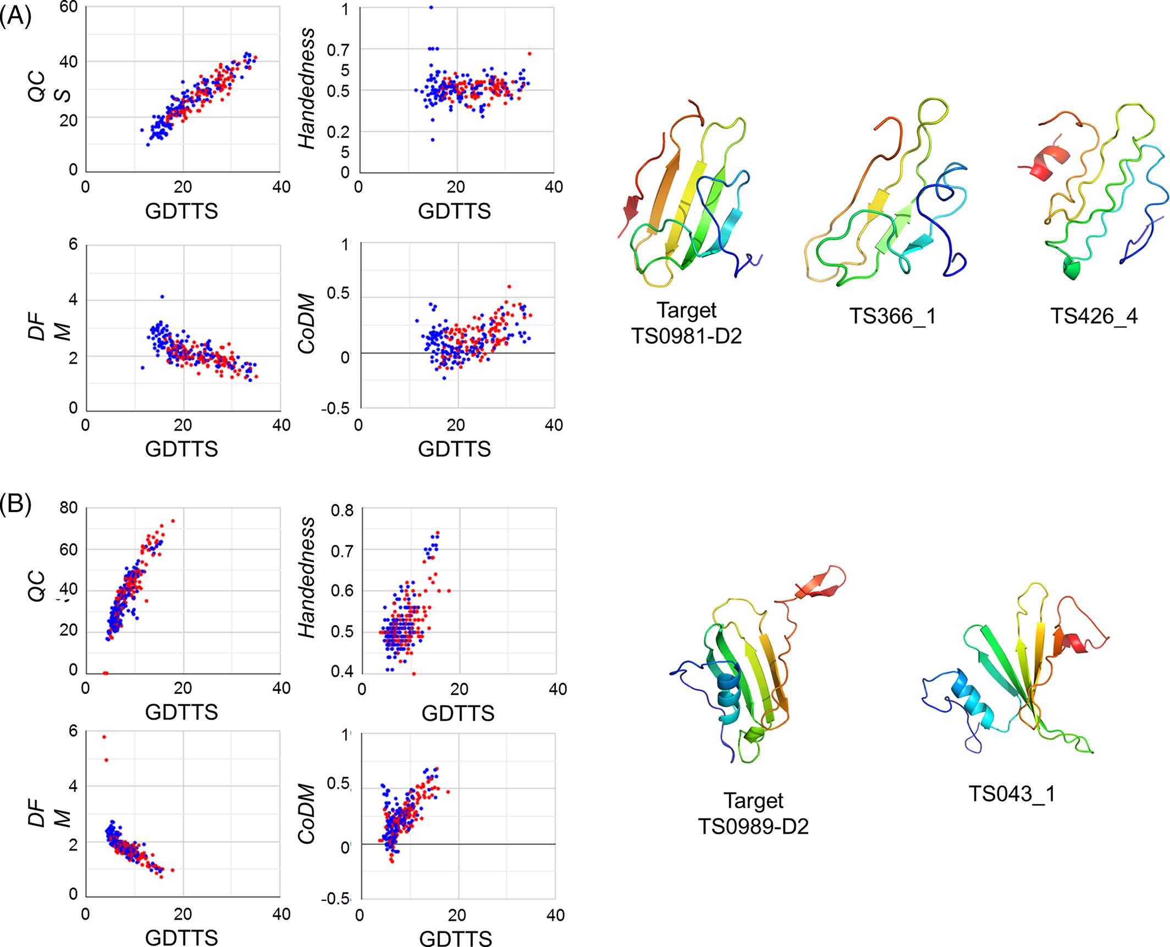
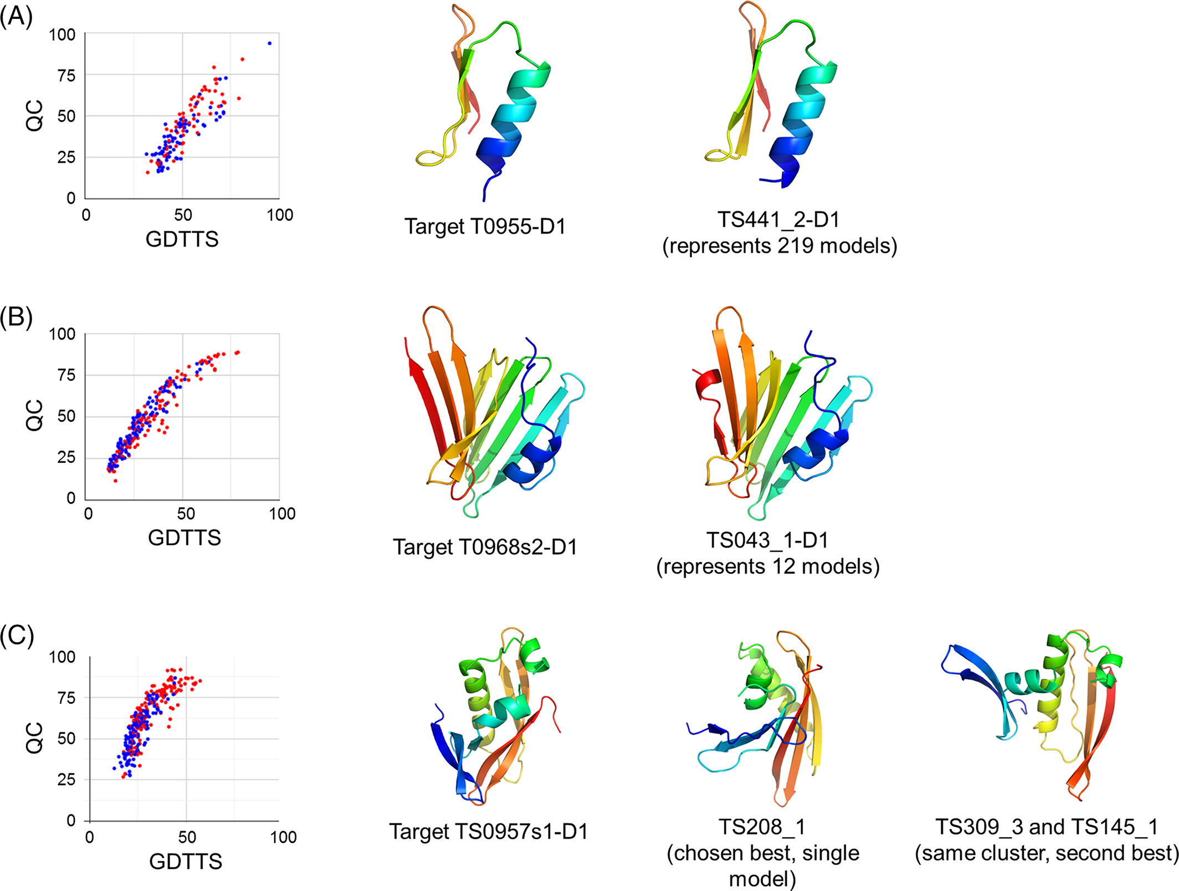
Examples of evaluations from CASP13
T0955-D1 (FM/TBM)
41 residues
T0957s2-D1 (FM)
154 residues
T0958-D1 (FM/TBM)
77 residues
TS441_2-D1 (219 models)
TS043_5
& TS043_1
TS431_1-D1 (32 models)
0.98 Å over full sequence
< 2.3 Å over 85% of the sequence
1.73 Å over full sequence
HHscore 19.46
LGA 93.4
Neff/L HHblits 0.02
HHscore 10.7
LGA 51
Neff/L HHblits 0.17
HHscore 48
LGA 69
Neff/L HHblits 0.39
Abriata, Tamo, Dal Peraro, Proteins 2019 (official CASP13 assessment)
https://onlinelibrary.wiley.com/doi/10.1002/prot.25787

Slide 9
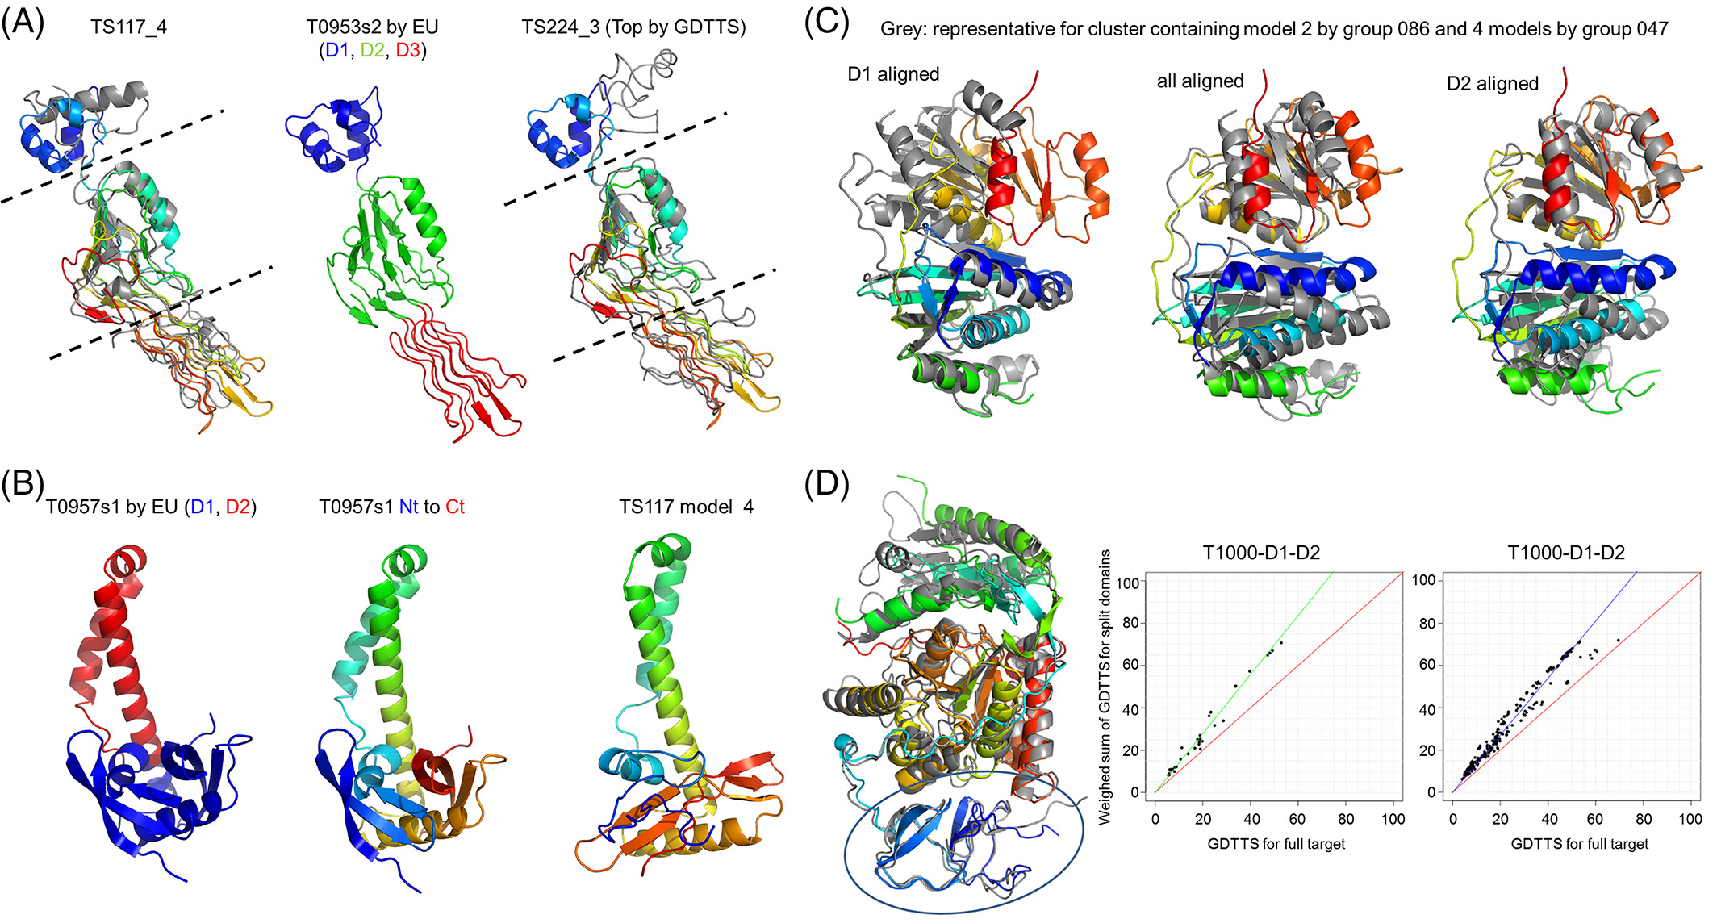
Examples of evaluations from CASP13: Move from Evaluation Units to Full Proteins?
Abriata, Tamo, Dal Peraro, Proteins 2019 (official CASP13 assessment)
https://onlinelibrary.wiley.com/doi/10.1002/prot.25787

Slide 10
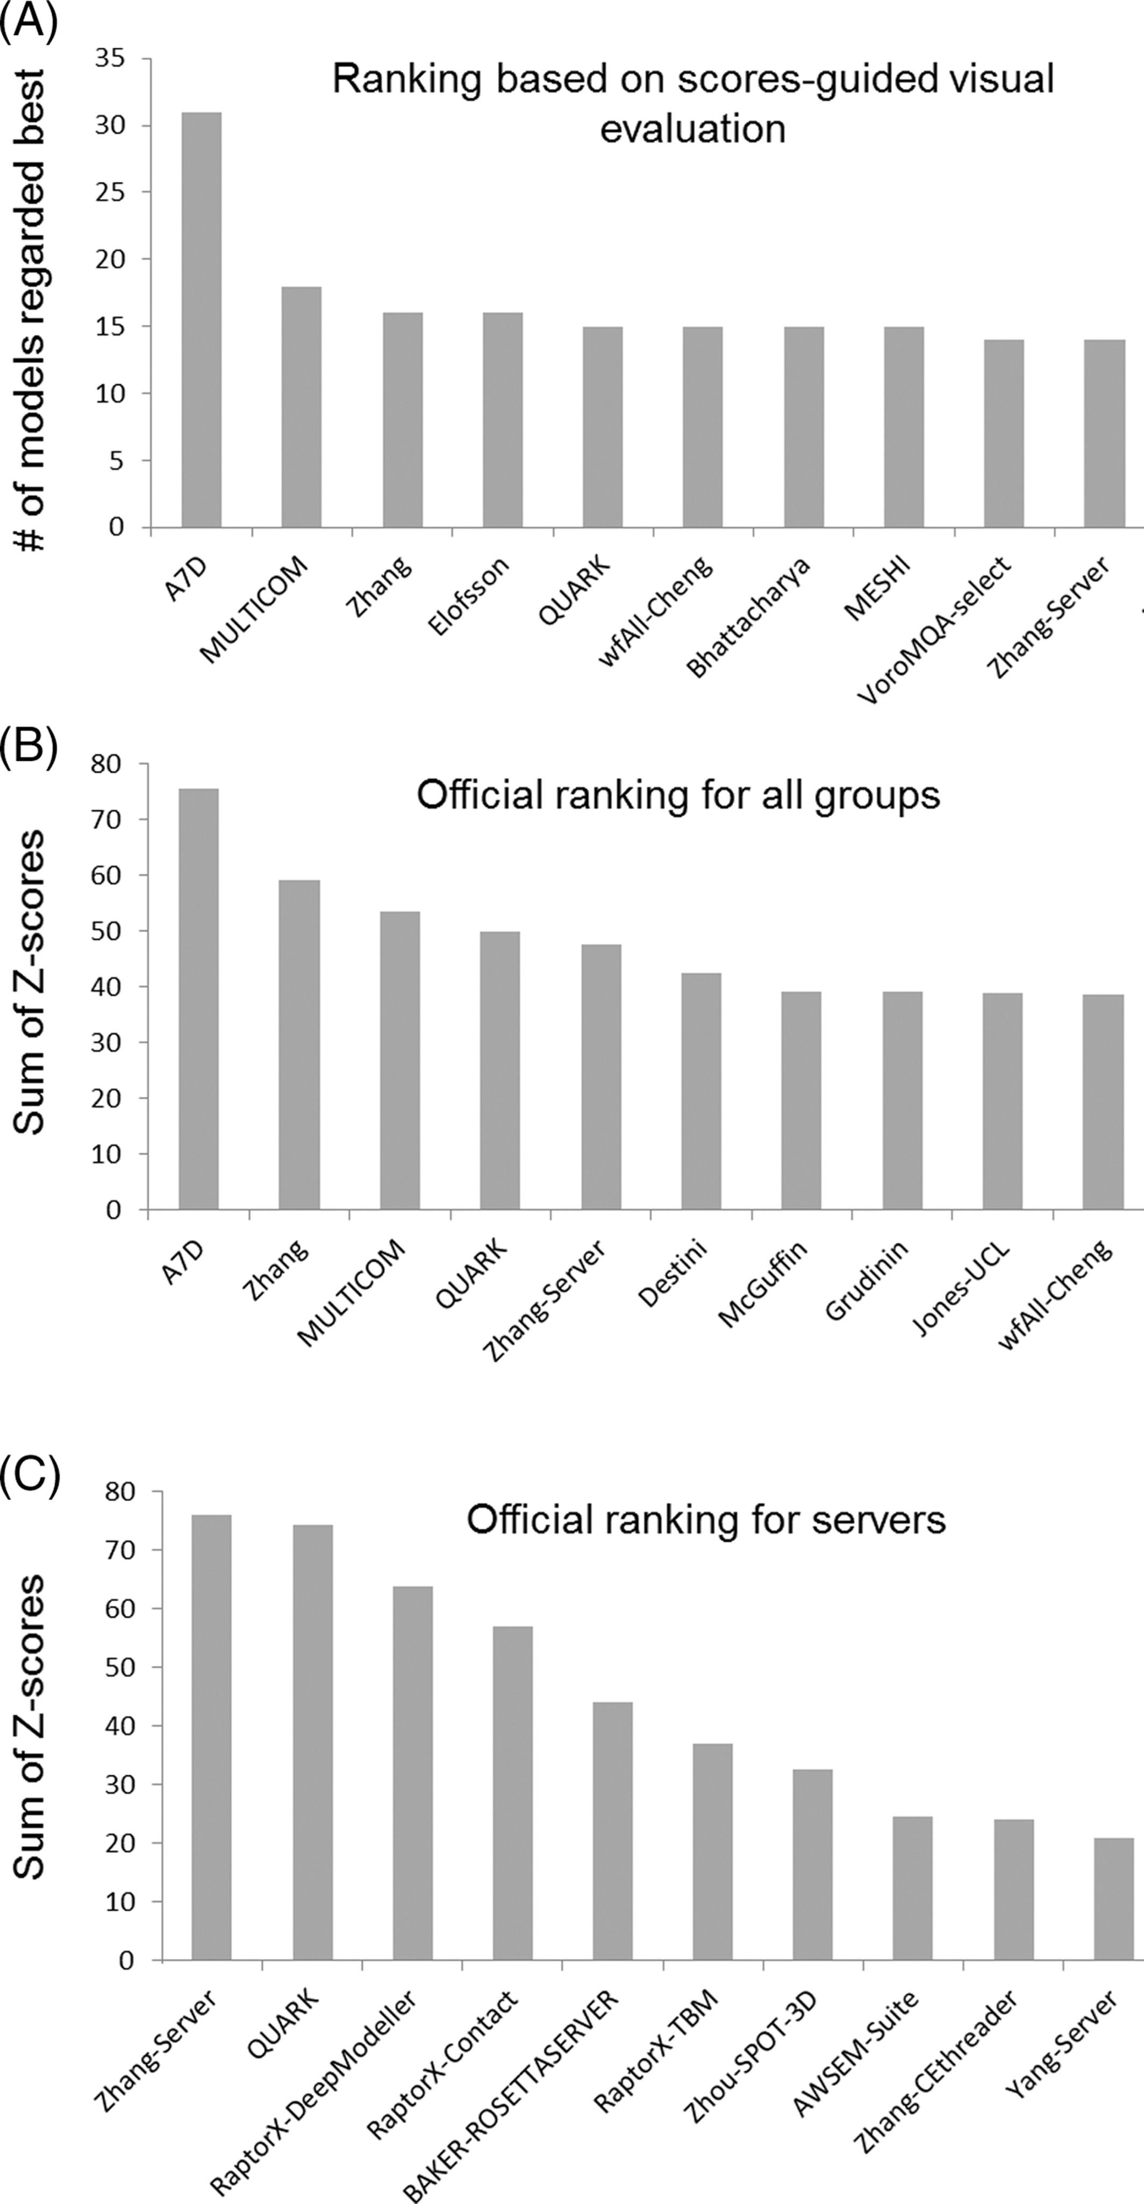
Ranking of best human and server predictors in CASP 13
Abriata, Tamo, Dal Peraro, Proteins 2019 (official CASP13 assessment)
https://onlinelibrary.wiley.com/doi/10.1002/prot.25787

Slide 11
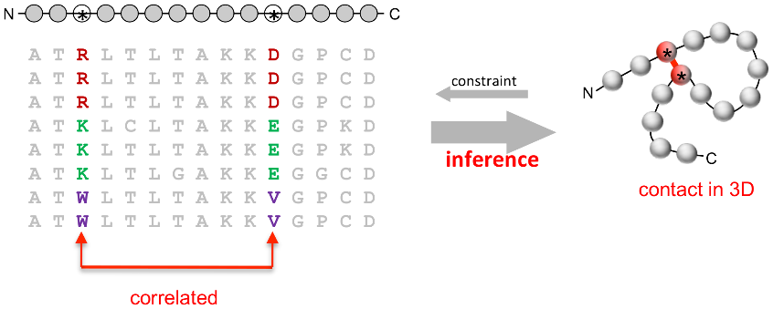
Progress in modeling very hard targets?
Machine Learning for molecular modeling
Coevolution-based contact prediction methods in literature
(1994)
(2018)
http://labriataphd.altervista.org/
Abriata, Tamo, Dal Peraro, Proteins 2019 (official CASP13 assessment)
https://onlinelibrary.wiley.com/doi/10.1002/prot.25787

Slide 12
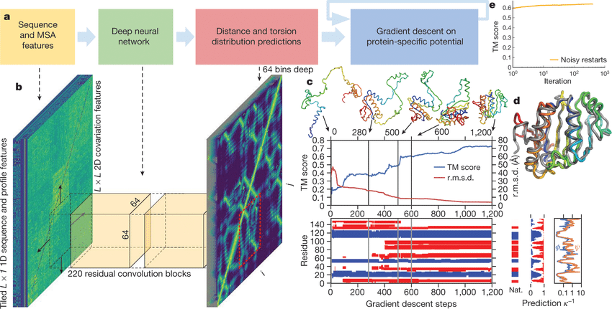
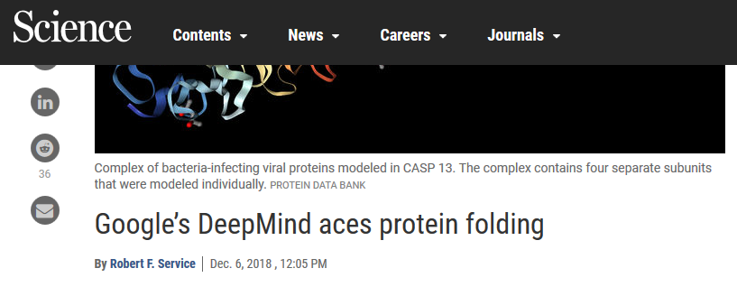
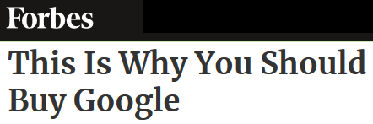
Machine learning for Protein structure (pre-AlphaFold 2)
Sequence
Features
Predictions
Folding
Alignments
Coevolution
Template search
Threading
Wang et al PLoS Comp Biol 2017
Kandathil et al Proteins 2019
Hou et al Proteins 2019
Xu PNAS 2020
Senior et al Nature 2020
Yang et al PNAS 2020
Contacts, distances and orientations from PDB structures
AF 1 simply engineered the SOTA to the max.
http://labriataphd.altervista.org/

Slide 13
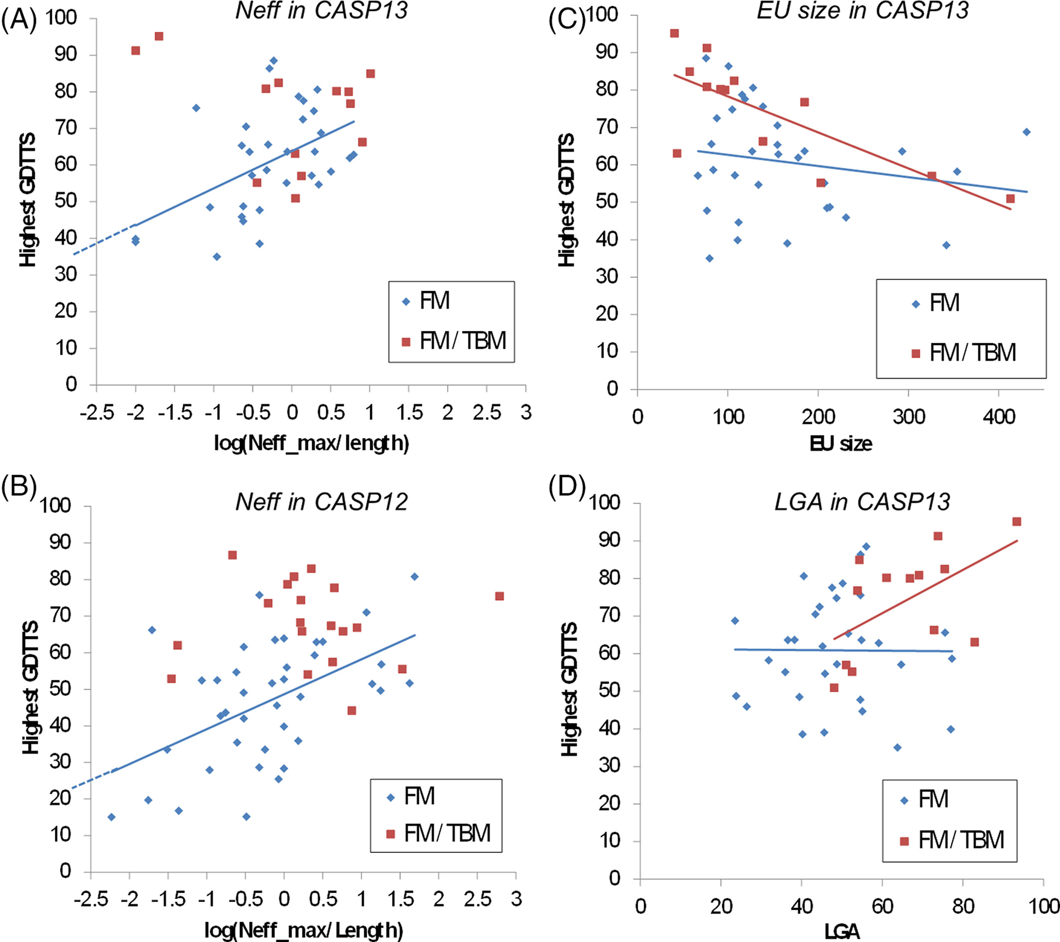
Limitations as of CASP13 ?
-3ry structure of domains,
little or no quaternary structure
-side chains not evaluated
-Nets may be ”recalling” structures
→ -Alignment depths: coevolution
data quite essential
- Exquisite details
* None “fully” solved even as of CASP16 / AlphaFold 2/3
* But global fold for individual evaluation units is “largely solved” since casp14
* Protein language models could have been the key, but aren’t stellar
Abriata, Tamo, Dal Peraro, Proteins 2019 (official CASP13 assessment) https://onlinelibrary.wiley.com/doi/10.1002/prot.25787

Slide 14
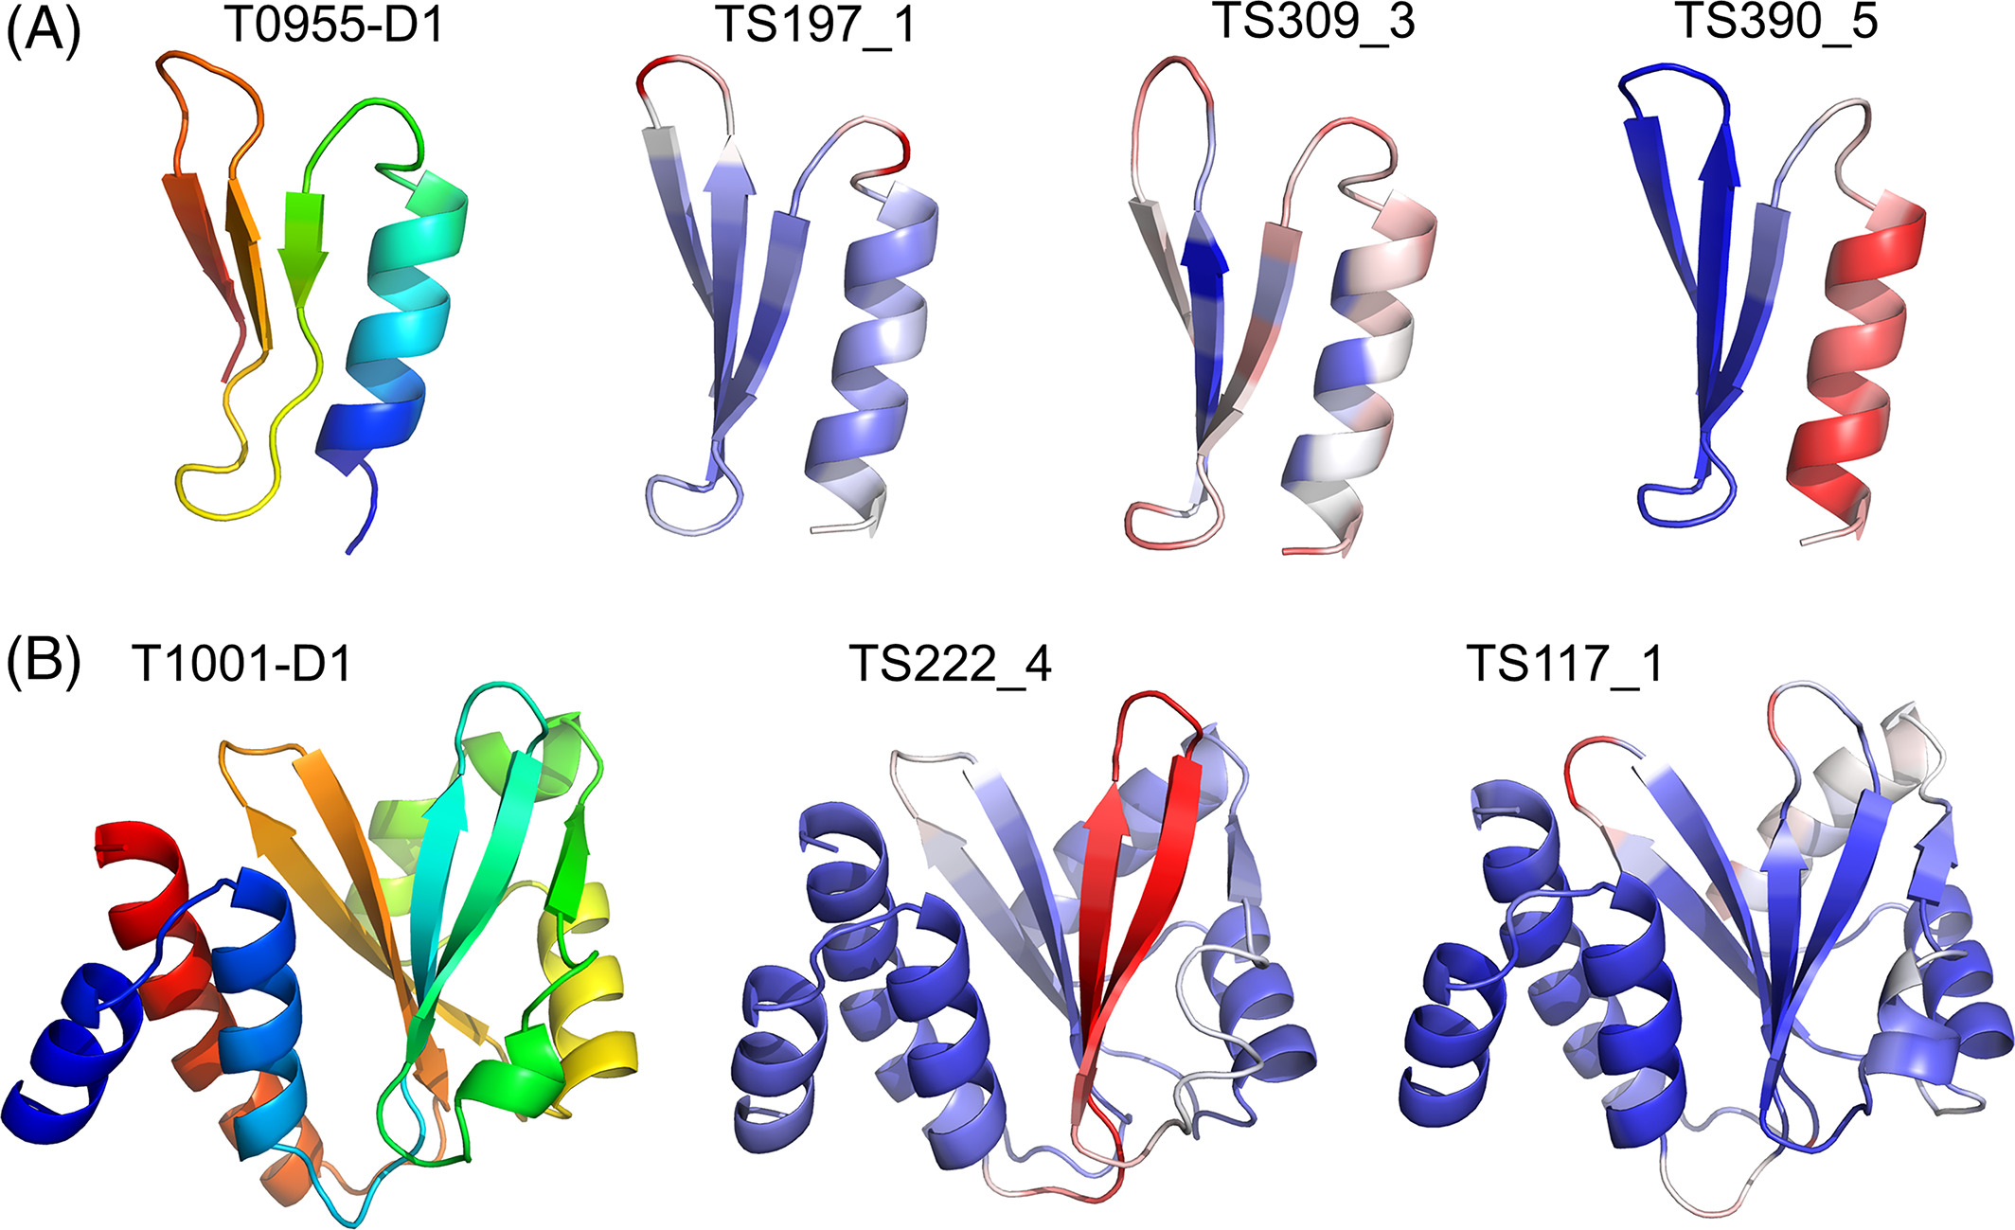
CASP13 prompts new routes for the future –already relevant in CASP14 !!
Time to drop splitting into EUs and assess whole structures only
Move on to harsher analyses focused on finer details: local details such as packing and side-chain conformations
Assessing not only the models but also predictions of quality estimates:
Abriata, Tamo, Dal Peraro, Proteins 2019 (official CASP13 assessment) https://onlinelibrary.wiley.com/doi/10.1002/prot.25787

Slide 15
How can you benefit from all this (as of CASP13)?
A quick overview now
For details see
- Abriata, Lepore & Dal Peraro Bioinformatics 2020
- And especially Abriata & Dal Peraro Briefings in Bioinformatics 2020
OUTDATED IN 1 YEAR !!
http://labriataphd.altervista.org/

Slide 16
SERVERS that implement these methods and you can use right away
Table 1. Webservers for template-less protein structure prediction. The list follows alphabetical order only. Additional tables in this work are reported in the supplementary information and at http://lucianoabriata.altervista.org/papersdata/bib2020.html.
Server [ref] | URL | Underlying methods | Assessment | Max. models delivered | Quality estimate | Output
C-QUARK [22] | https://zhanglab.ccmb.med.umich.edu/C-QUARK/ | ML-assisted contact prediction | CASP13 [16] | 5 | Own C-score (QUARK-like) plus estimated TM score and RMSD | Models and contact map
C-I-TASSER [22] | https://zhanglab.ccmb.med.umich.edu/C-I-TASSER/ | ML-assisted contact prediction | CASP13 [16] | 5 | Own C-score (I-TASSER-like) plus estimated TM score and RMSD | Models, predicted contact map, and extended I-TASSER-like analysis (PDB structural matches, gene ontology predictions, predicted ligands, etc.)
RaptorX-Contact [23] | http://raptorx.uchicago.edu/ContactMap/ | Contact prediction | CASP13 [16] | 5 | Own score plus residue-wise score estimated from CNS restraint violations | Models and predicted contact map
RaptorX-DeepModeller [23,24] | http://raptorx.uchicago.edu/StructPredV2/predict/ | Contact and distance prediction | CASP13 [16] | 5 | Own score plus residue-wise scores estimated from CNS restraint violations | Models and predicted contact and distance maps
Robetta [26–28] | https://robetta.bakerlab.org/ | Rosetta assisted by contact predictions and homology modeling using PDB and the Gremlin/Rosetta dataset of Table 2 | CASP13 [16] | 5 | Estimated GDTTS for global quality (linearly related to TM score), plus residue-wise quality estimates | Models, intermediate predictions, quality estimate plots
trRosetta [21] | https://yanglab.nankai.edu.cn/trRosetta/ | Contact, distance and orientation prediction | Not available; presumably similar to AlphaFold [21] | 5 | Estimated TM score and RMSD | Models, predicted contacts, distances and orientations
http://labriataphd.altervista.org/
Abriata & Dal Peraro Brief Bioinf 2020

Slide 17
DATASETS of models precomputed for structurally uncharacterized PFAM domains, that you can consult right away
Table 2. Databases of precomputed models. See overlap and PFAM coverage in Figure S3; and examples comparing predictions to subsequent structures in Figure S4. Additional tables are reported in the supplementary information and at http://lucianoabriata.altervista.org/papersdata/bib2020.html. The list follows alphabetical order only.
Dataset [ref] | URL | Underlying methods | Quality estimate for models | Average TM score in our tests | Additional comments
DMPfold [32] | http://bioinf.cs.ucl.ac.uk/downloads/dmpfold/pfam_models.tgz | Contact predictions from DeepMetaPSICOV, associated server at http://bioinf.cs.ucl.ac.uk/psipred/ | Estimated TM scores on Github site | 0.54 (9 models) | Main table includes models expected of high quality, but website includes many more predictions: https://github.com/psipred/DMPfold
Gremlin/Rosetta, 2015 [30] and 2017 [26] | https://gremlin2.bakerlab.org/meta/aah4043_final.zip and https://gremlin2.bakerlab.org/struct.php | Rosetta assisted with contact predictions from Gremlin | Own scores | 0.80 (12 models) | Website includes comparisons to actual structures, showing that most are not new folds: https://gremlin2.bakerlab.org/meta_struct.php
PConsC3 [31] | http://c3.pcons.net/static/download/pfam.tar.gz | PConsC3 server at http://c3.pcons.net/pred/ | Own scores | 0.51 (13 models) | See associated server for user submissions and additional data at http://c3.pcons.net/pred/
Tara3D [33] | https://zhanglab.ccmb.med.umich.edu/Tara-3D/ | C-I-QUARK server from Table 1 | Estimated TM scores on authors’ website | 0.53 (9 models) | Used marine metagenomics. See https://zhanglab.ccmb.med.umich.edu/Tara-3D/
Modelsearch [34] | http://lucianoabriata.altervista.org/modelsearch/ | (This website provides a sequence search interface for the datasets above plus others)
At least 1 model for 2089 structurally uncharacterized PFAM families (12% of PFAM)
http://labriataphd.altervista.org/
Abriata & Dal Peraro Brief Bioinf 2020

Slide 18
The technology extends PFAM coverage by 12%
Tara
444 (40)
Gremlin
639 (71)
202
PConsC3 411
(58)
180
2
DMPfold
1475 (31)
43
163
171
1
4
814
48
0
346
24
63
61
wwPDB: Structures for 9878 PFAM families
(PDBfam by Nov 2019)
55% of PFAM
PFAM: 17929 families
(v32, Sep 2018)
http://labriataphd.altervista.org/
Abriata & Dal Peraro Brief Bioinf 2020

Slide 19
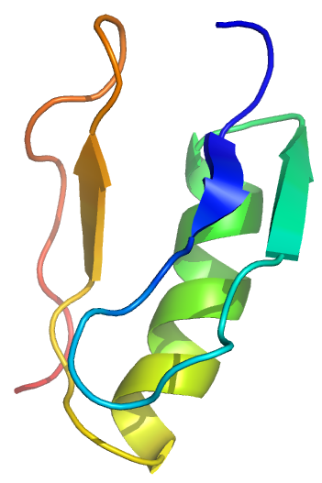
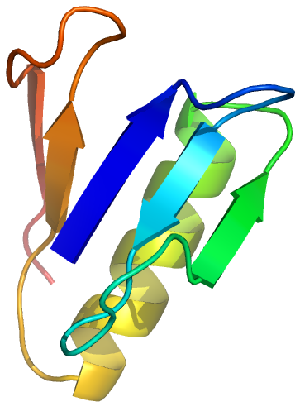
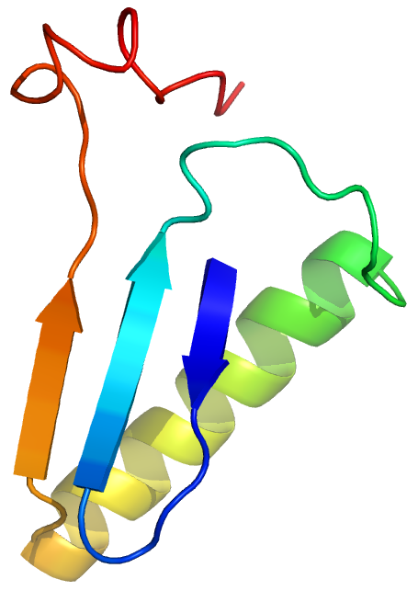
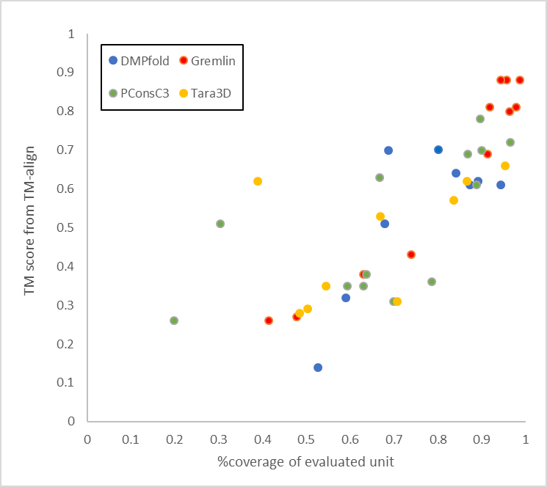
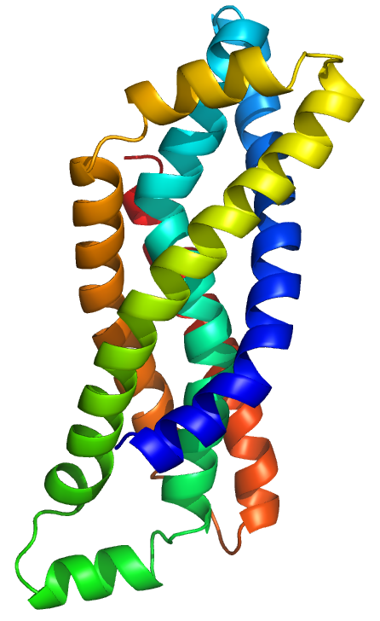
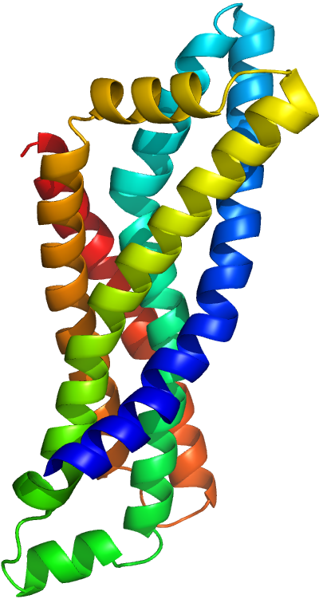
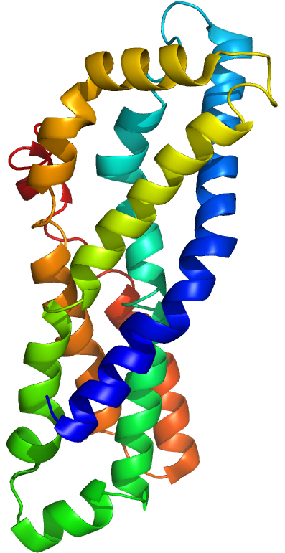
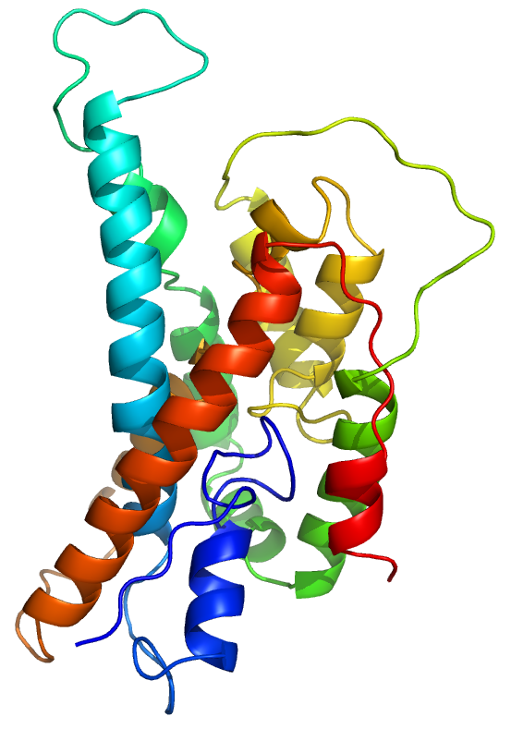
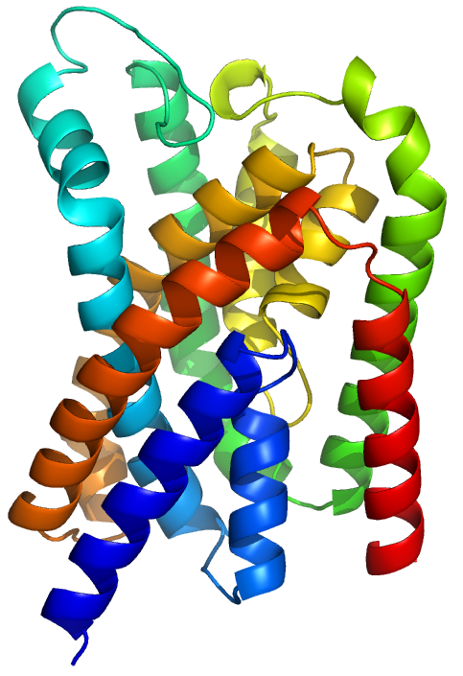
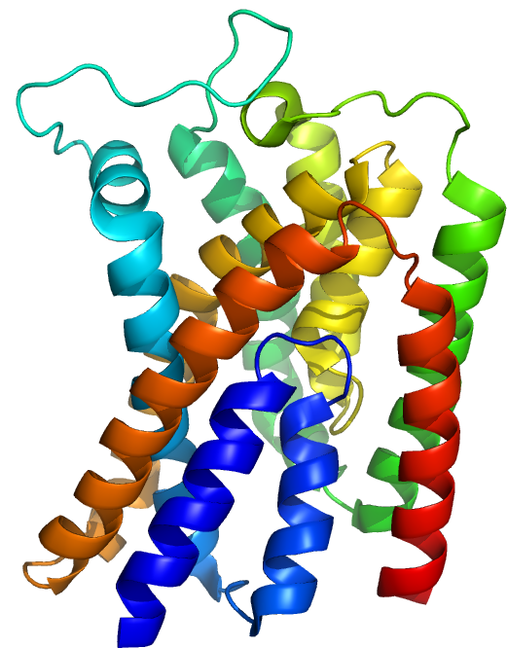
Since publication of these datasets, some experimental structures came out, allowing us to evaluate them
PF09954
PConsC3
Gremlin
PDB 5jn6
1
TM 0.35 , 3.3 Å
(41 residues)
TM 0.38, 4.2 Å
(41 residues)
65 residues
Within 1-3 Å backbone RMSD
DMPfold Gremlin
PConsC3 Tara3D
0.9
PF02405
0.8
DMPfold
Gremlin
PDB 6ic4
0.7
Very good models
0.6
TM score from TM align
Topology ok
0.5
0.4
Overall shape ok
0.3
TM 0.70, 4.1 Å
(206 residues)
TM 0.81, 2.7 Å
(236 residues)
257 residues
0.2
No better than a random model
PF02673
0.1
PConsC3
Gremlin
PDB 6fmw
0
0
0.1
0.2
0.3
0.4
0.5
0.6
0.7
0.8
0.9
1
%coverage of evaluated domain
TM 0.70 ; 4.1 Å
(243 residues)
TM 0.81 ; 3.3 Å
(264 residues)
270 residues
http://labriataphd.altervista.org/

Slide 20
One last tool: modelsearch
Contact-based models
DMPfold, Pcons, Tara3D, Gremlin
MA, PMP, PMDB
CASP models
Paper SIs
etc…
SASBDB
PDB-Dev
>your_protein
PRTEINSEQENCE
http://labriataphd.altervista.org/
→ Follow modelsearch link
Models
http://labriataphd.altervista.org/
Abriata et al Bioinformatics 2020

Slide 21
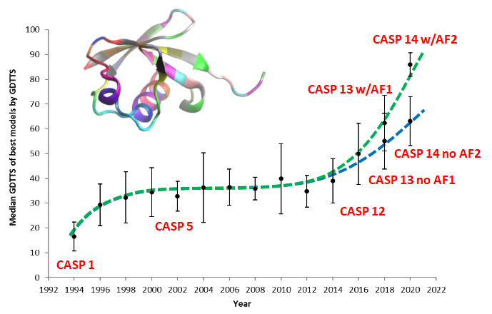
Protein Structure Prediction in the era of AlphaFold2

Slide 22
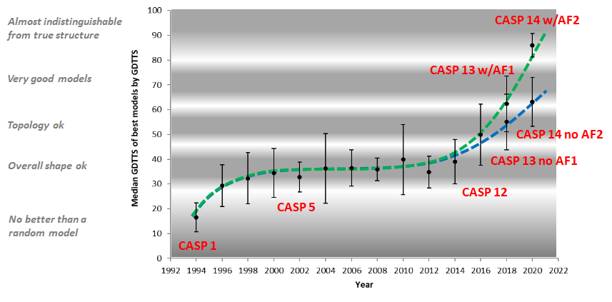
In CASP14 we can truly acknowledge that Deepmind
beat the academic groups by far
and cracked a big part of the structure prediction problem

Slide 23
How does AlphaFold 2 work?
Obvio que bien no lo entiendo
(el paper en Nature presenta elementos nuevos incluso
para el campo de machine learning),
así que esto es lo que puedo cazar,
resumido y comparado con AlphaFold 1
y con lo que otros programas hacen al momento,
remarcando algunos puntos que me parecen relevantes

Slide 24
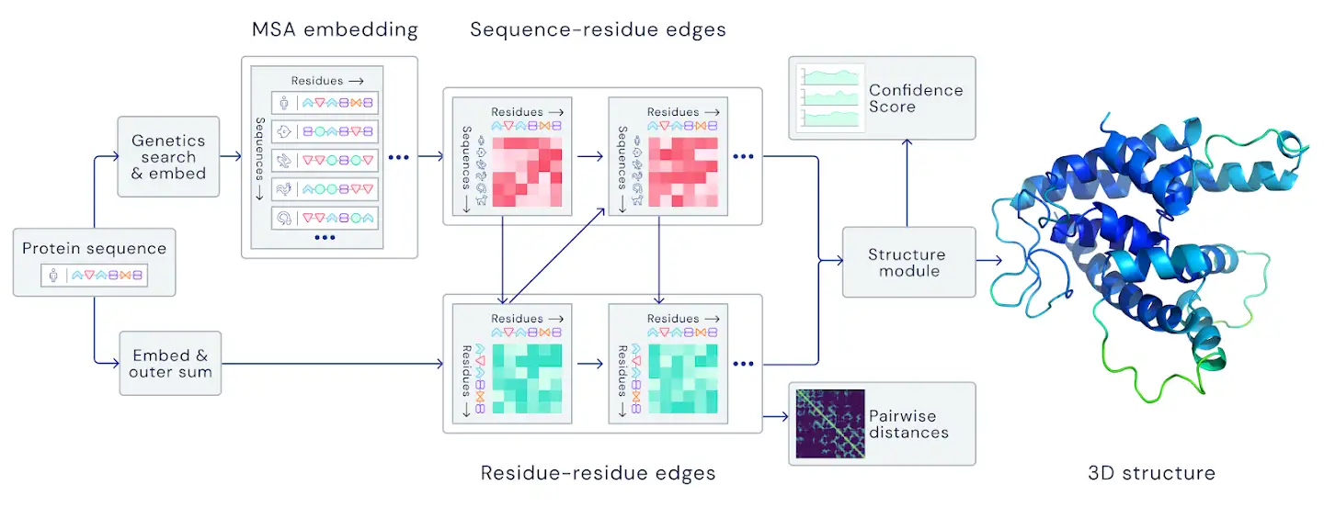

Slide 25
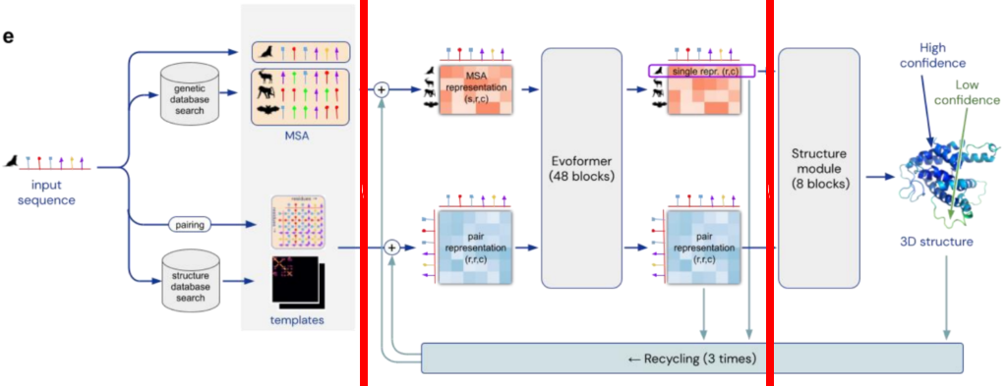
* Builds an MSA and detects templates, extracts the information from them using a neural network
- no explicit coevolution calculations
- the MSA is cleaned and paired internally –so far the AF2 is the ONLY one doing this!
… and then passes that information to another neural network that produces the 3D model
- no folding as in AF1 or every other structure predictor… the network itself builds the 3D model.
* The model works iteratively. After generating a structure, it will take all the information (i.e. MSA representation, pair representation and predicted structure) and pass it back to the beginning of the Evoformer blocks, the second part of our diagram
* The network outputs not only 3D models but also confidence predictions (more later)
* Network is end-to-end differentiable, which is important for spin off applications like design.
More in original paper and in https://www.blopig.com/blog/2021/07/alphafold-2-is-here-whats-behind-the-structure-prediction-miracle/

Slide 26
How to use AlphaFold 2 ?
Download at https://github.com/deepmind/alphafold
* 2.2 TB
* Libraries, dependencies, need to build MSA, etc.
* Need a GPu
* Or… use DeepMind’s Google Colab version:
https://colab.research.google.com/github/deepmind/alphafold/blob/main/notebooks/AlphaFold.ipynb
(but has limitations)

Slide 27


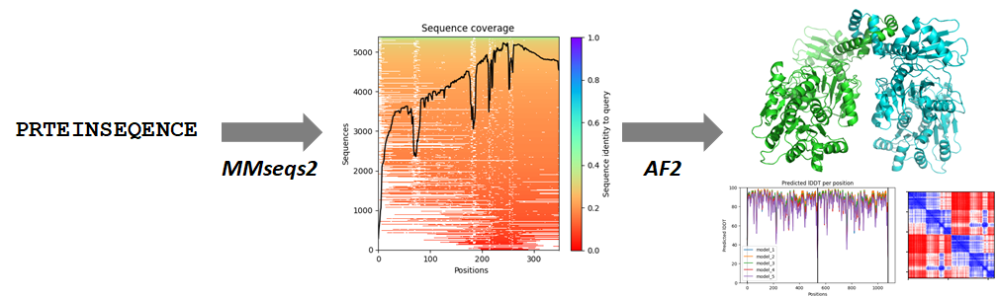
Using AF2 in the era of online programming tools
Not just AF2, but also an efficient MSA builder, MMseqs2
No need to download tons of sequences (as in AF2) because MMseqs2 runs in a server
https://github.com/sokrypton/ColabFold
https://www.nature.com/articles/s41592-022-01488-1

Slide 28
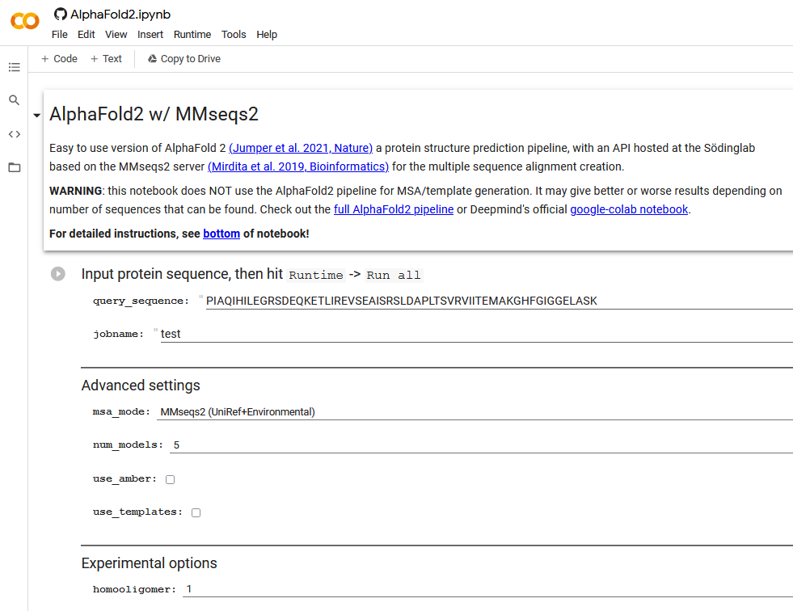
Using AF2 in the era of online programming tools
SHOW
https://github.com/sokrypton/ColabFold
https://github.com/sokrypton/ColabFold
https://www.nature.com/articles/s41592-022-01488-1

Slide 29

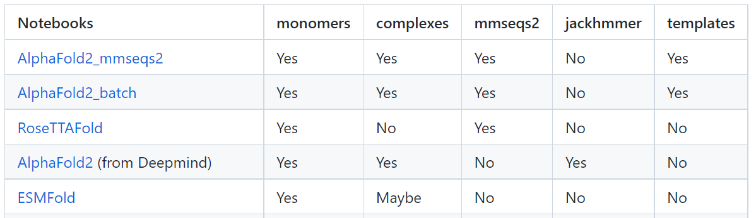
Using AF2 in the era of online programming tools
https://github.com/sokrypton/ColabFold
https://www.nature.com/articles/s41592-022-01488-1

Slide 30
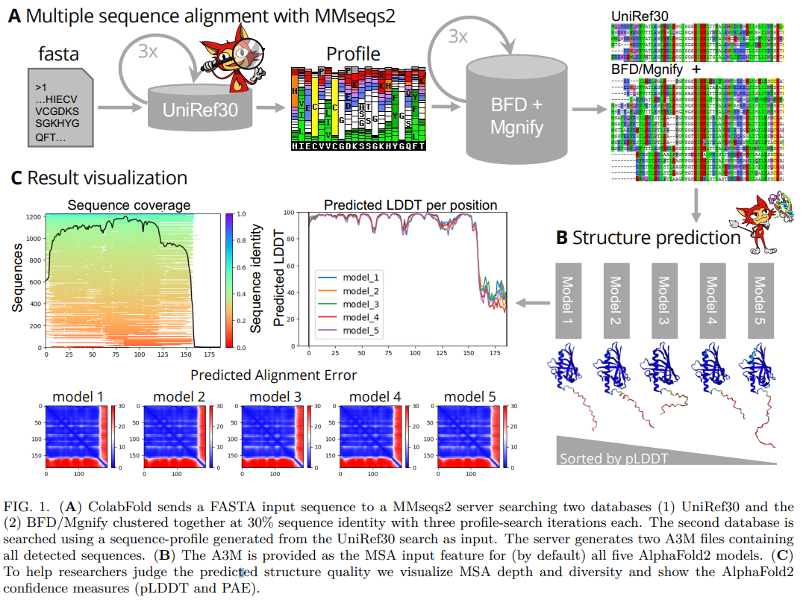
MMseqs2 at Nature Biotechnology: https://www.nature.com/articles/nbt.3988

Slide 31
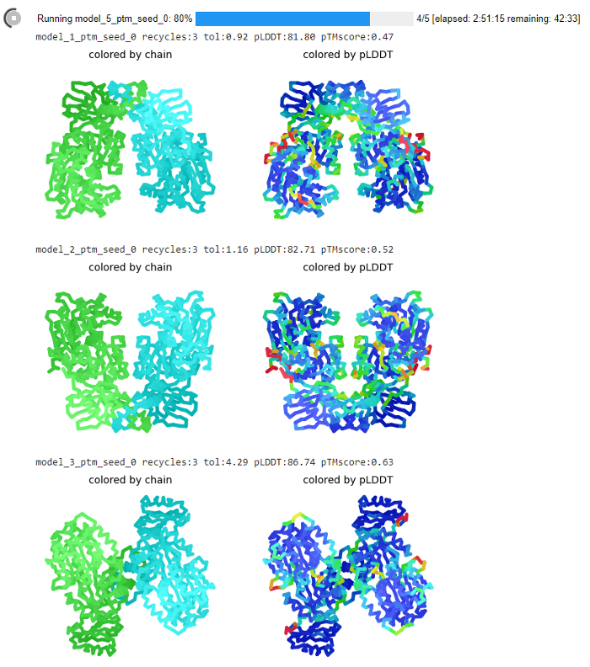
Check the models as ColabFold runs…

Slide 32
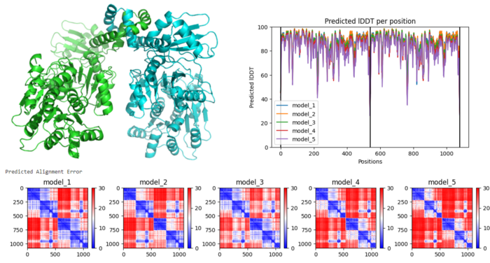
Using AF2 in the era of online programming tools
Global TM estimation
pLDDT
PAE
Complete with global, residue-wise and residue-residue quality estimates!
And even in-colab relaxation with MD

Slide 33
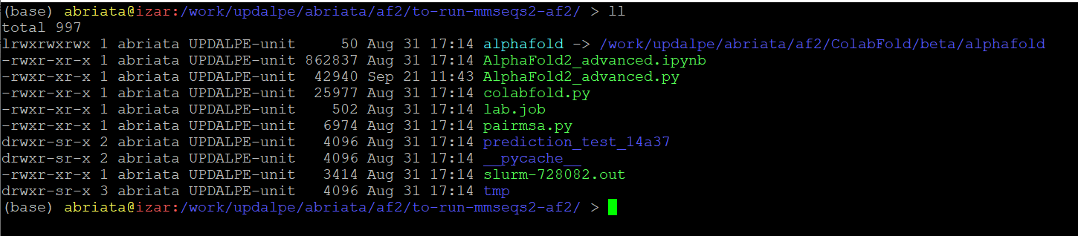
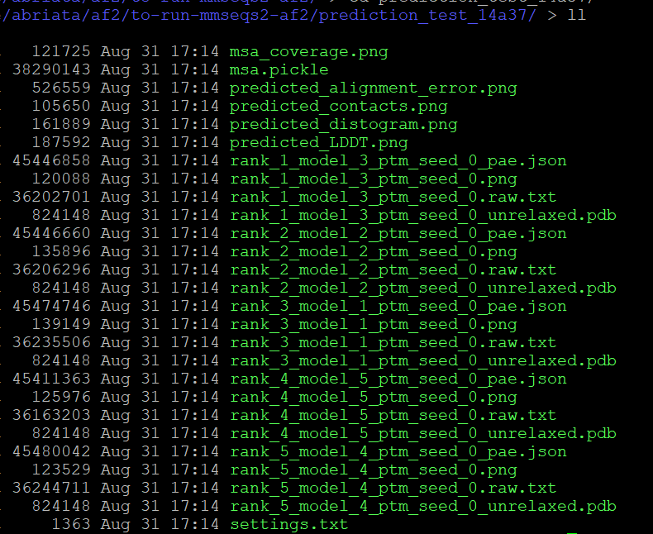

Using ColabFold in a High Perf Computer
Thanks Lucien for the installation
GPUs with more memory → Bigger proteins
Practically infinite time for jobs

Slide 34



2021 was a busy year…
RosettaFold, Baker’s response to AF2 (1 day ahead, but not tested in CASP14!)
Deepmind’s AF2
Deepmind-EBI database of AF2 models

Slide 35

EBI-Deepmind
Structural models precalculated for 214 million proteins
https://www.ebi.ac.uk/Tools/sss/fasta/
https://alphafold.ebi.ac.uk/
-- Models also integrated into UniProt --

Slide 36
EBI-Deepmind
Structural models precalculated for 214 million proteins
“Spin offs” as of Oct. 2023
Foldseek: https://www.nature.com/articles/s41587-023-01773-0
Two Nature papers analyzing the “protein universe”: https://www.nature.com/articles/s41586-023-06510-w and https://www.nature.com/articles/s41586-023-06622-3
AlphaMissense: https://medium.com/@nexcoanalytics/alphamissense-transforming-genetic-variant-prediction-for-cutting-edge-biology-and-for-precision-f639745af62e or paper at https://www.science.org/doi/10.1126/science.adg7492

Slide 37
AlphaFold 2’s limitations + hints + coming up next
Check 0D (TM score), 1D (pLDDT), and 2D (PAE) scores
Careful with oligo states,
especially in the database which assumes monomers
Disorder ok only for short segments
Templates: good if you have them, but they also skew predictions heavily (alt conf, binding sites, etc.)
BUT:
New database by Baker lab specific for eukaryotic multimers
AlphaFold multimer –interesting: there’s no paper!
pLDDT best-ever predictor of disorder
No templates? Large sequence alignments compensate
https://towardsdatascience.com/alphafold-based-databases-and-fully-fledged-easy-to-use-alphafold-interfaces-poised-to-baf865c6d75e → go to “Pushing the limits:…”

Slide 38
AF2@CASP14
Preprints + derived papers + Social media
AF2 paper
# searches
Date
July 15, 2021: AlphaFold2 paper in Nature + source code at GitHub + basic Colab by Deepmind
July 18, 2021: MMSeqs2 + AlphaFold in ColabFold on Twitter
July 21, 2021: https://towardsdatascience.com/google-colab-notebooks-are-already-running-deepminds-alphafold-v-2-92b4531ec127
August 15, 2021: MMSeqs2 + AlphaFold / RoseTTAFold preprint in bioRxiv:
https://www.biorxiv.org/content/10.1101/2021.08.15.456425v1
August 18, 2021: https://towardsdatascience.com/the-hype-on-alphafold-keeps-growing-with-this-new-preprint-a8c1f21d15c8
And more and more tweets, preprints, and papers… Everything moving very fast!!

Slide 39
Additional applications beyond modeling itself (mostly from twitter, initially anecdotal)
Prediction of protein complexes (new works out)
Prediction of disordered regions
Easily modeling inside cryo-EM (follow Tristan Croll)
Correcting models from cryo-EM (Tristan Croll)
Models for molecular replacement (already for some time in CASP, many in CASP14
Structure search on the models

Slide 40

AlphaFold 2 spin-offs three months after its official release
https://towardsdatascience.com/alphafold-2-spin-offs-three-months-after-its-official-release-90c2d8714757
(EBI-AlphaFold)
(Baker lab using AlphaFold + RoseTTAFold)
(New from Deepmind)
Especially https://www.biorxiv.org/content/10.1101/2021.09.26.461876v1
Para corregir a los medios...
Opiniones sobre machine learning en biología
Algunos casos interesantes

Slide 41
AlphaFold 2 spin-offs three months after its official release
https://towardsdatascience.com/alphafold-2-spin-offs-three-months-after-its-official-release-90c2d8714757
Experimental structural biologists joined efforts to assess the utility of AlphaFold in their fields of research
% of proteome covered with structural data (experimental structures + homology models + AF2 models).
In particular for human proteome: 50% covered with structural data, and 20% is just long disordered segments or fully disordered proteins.
Using pLDDT as disorder predictor works better than any ad hoc disorder predictor.
Examples of using models for molecular replacement in X-ray structure resolution and direct use for modeling in cryo-EM.
Some models good enough for applications that need high resolution, such as ligand design.
EBI-AlphaFold keeps growing. The goal is to cover all UniProt.
Baker lab: AF2 + RoseTTAFold models spanning almost all key processes in Eukaryotic cells for 104 protein assemblies which have not been previously identified, and 608 which have not been structurally characterized.

Slide 42

https://www.nature.com/articles/s41594-022-00849-w

Slide 43
Some conclusions as of December 2021
New tools for protein modeling pose a real advancement for biology,
but be careful of limitations
Digital education for online programming
New ways to communicate science:
  Twitter for rapid spread. Deepmind even CITES tweets!
  Preprinting for rapid dissemination –veo poco de Argentina
  Reviewed blogging for rapid outreach (Medium)
  Advances go too fast for traditional publishing
  Role of regular publications? New ways to peer review? The case of AlphaFold multimer

Slide 44
1. AI
AI for protein structure prediction
“Coevolution”
Pure “understanding” of protein structure inside the neural network itself
ML of distances, angles…
https://onlinelibrary.wiley.com/doi/abs/10.1002/prot.25423
https://onlinelibrary.wiley.com/doi/abs/10.1002/prot.25787
AF-multimer in action

Slide 45


1. AI
AI: From protein structure prediction to protein design
https://www.science.org/doi/10.1126/science.add2187

Slide 46






1. AI
AI: Interface predictions with PESTO
(ProtEin Structure TransfOrmer – https://pesto.epfl.ch )
nn nearest
neighbours
3
1
4
r
2
layer t
Beating the state of the art with no parametrizations, no surface calculations, etc.!
1
2
3
4
…
nn
    Lucien Krapp
… in just ms/structure
Website
Preprint in bioRxiv
https://www.biorxiv.org/content/10.1101/2022.05.09.491165v1
Notes:
We describe a protein structure as point clouds and its geometry is described through pairwise distances and relative displacement vectors - The atoms are described using only their elemental names and coordinates without any explicit numerical parametrization such as mass, radius, charge or hydrophobicity.
We define a geometrical transformer operation acting on this cloud of points to update these states using the states and geometry in their local neighborhood.
The query is encoded from the central atom state and used with the keys and values of the interactions to compute the output state with a multi-headed attention operation. The model is composed of multiple layers of geometric convolutions with a fixed number of nearest neighbors (nn).
The structure is reduced to a residue representation through a transformer-based geometric pooling. The residue states are collapsed and the final prediction is computed from a multi-layer perceptron (MLP).
independent of the order of the atoms and order of the interactions. The attention operation allows for a dynamic number of nearest neighbors (nn). However, in practice, the operation is much more computationally efficient with a fixed number of nearest neighbors. In the same fashion as applying convolution operations on an image, chaining geometric transformers can propagate information at a longer range than the local context of a single operation. The main architecture is based on a bottom-up approach, starting from a small context of 8 nearest neighbors (≈ 3.4 Å radius) up to long-range interactions with 64 nearest neighbors (≈ 8.2 Å radius), see Figure 1c. The size of the context gradually increases allowing the model to progressively include more information while remaining cheaper in computation requirements and memory for deep models. The residual connection between geometric transformers enables us to train deeper neural network architectures. Two additional modules aggregate the atom-based geometric description at the residue level independently of the number of atoms within a residue (geometric residue pool) and predict whether each amino acid is at an interacting interface or not (interface model).
The interactions between atoms for all nearest neighbors is encoded and a multi-headed attention layer decodes and regulates the propagation of the information,

Slide 47


1. AI
AI: Designing proteins with CARBONARA
Design (w/ions, ligands, waters…!)
Design vs. Deep seq
Prediction
Design vs. MSA
Residue number
MSA
Deep-seq
    Lucien Krapp & Fernando T. P. Meireles
Notes:
We describe a protein structure as point clouds and its geometry is described through pairwise distances and relative displacement vectors - The atoms are described using only their elemental names and coordinates without any explicit numerical parametrization such as mass, radius, charge or hydrophobicity.
We define a geometrical transformer operation acting on this cloud of points to update these states using the states and geometry in their local neighborhood.
The query is encoded from the central atom state and used with the keys and values of the interactions to compute the output state with a multi-headed attention operation. The model is composed of multiple layers of geometric convolutions with a fixed number of nearest neighbors (nn).
The structure is reduced to a residue representation through a transformer-based geometric pooling. The residue states are collapsed and the final prediction is computed from a multi-layer perceptron (MLP).
independent of the order of the atoms and order of the interactions. The attention operation allows for a dynamic number of nearest neighbors (nn). However, in practice, the operation is much more computationally efficient with a fixed number of nearest neighbors. In the same fashion as applying convolution operations on an image, chaining geometric transformers can propagate information at a longer range than the local context of a single operation. The main architecture is based on a bottom-up approach, starting from a small context of 8 nearest neighbors (≈ 3.4 Å radius) up to long-range interactions with 64 nearest neighbors (≈ 8.2 Å radius), see Figure 1c. The size of the context gradually increases allowing the model to progressively include more information while remaining cheaper in computation requirements and memory for deep models. The residual connection between geometric transformers enables us to train deeper neural network architectures. Two additional modules aggregate the atom-based geometric description at the residue level independently of the number of atoms within a residue (geometric residue pool) and predict whether each amino acid is at an interacting interface or not (interface model).
The interactions between atoms for all nearest neighbors is encoded and a multi-headed attention layer decodes and regulates the propagation of the information,

Slide 48


1. AI
AI for (natural/protein) language processing
BERT
Elements of protein language models already existed before AF2 and were used by it
https://www.nature.com/articles/s41586-021-03819-2
Next, huge pLMs could predict protein structures right away, without MSAs: (ESMfold)
https://www.science.org/doi/10.1126/science.ade2574
https://towardsdatascience.com/protein-structure-prediction-a-million-times-faster-than-alphafold-2-using-a-protein-language-model-d71c55e6a4b7

Slide 49

https://ai.facebook.com/blog/protein-folding-esmfold-metagenomics/

Slide 50
What’s next after the “main” AI revolution in modeling?
What’s Up after AlphaFold on ML for Protein Structure Prediction? Automated Rolling
CASP kept rolling, now looking at other problems
Meanwhile: Ongoing evaluations by CAMEO: https://www.cameo3d.org/
→ Eventually we got AF3 and other “multimodal AI systems”: RoseTTAFold-AllAtoms, Chai-1, Boltz-1 and 2, etc. They accept not just protein sequences but also nucleic acids, small molecules and ions.
→ Happened kind of in parallel for prediction and for design
Language processing models, applied to protein structure prediction
Protein Structure Prediction a Million Times Faster than AlphaFold 2 Using a Protein Language Model
https://towardsdatascience.com/protein-structure-prediction-a-million-times-faster-than-alphafold-2-using-a-protein-language-model-d71c55e6a4b7
The paper: https://www.nature.com/articles/s41587-022-01432-w
How Meta is trying to irrupt structural biology with language models
https://ai.facebook.com/blog/protein-folding-esmfold-metagenomics/
https://www.biorxiv.org/content/10.1101/2022.07.20.500902v2.full.pdf
https://www.biorxiv.org/content/10.1101/2022.04.10.487779v2.full.pdf
https://www.biorxiv.org/content/10.1101/2021.07.09.450648v2.full.pdf

Slide 51


1. AI
More direct applications of Natural Language Processing?
(Natural) Language Processing / OpenAI’s GPT-3 and DallE2
Text → Text
Text → Image
Summarize or Expand
Link pieces of text & extract “conclusions”
https://medium.com/towards-data-science/gpt-3-like-models-with-extended-training-could-be-the-future-24-7-tutors-for-biology-students-904d2ae7986a
“Sentiment analysis”
Compile table from text, or create text from table
Question/Answer “Oracle”, even orally
https://www.youtube.com/watch?v=wH32_nu7z1c
https://www.youtube.com/watch?v=7wY3ZS1Uz-Y
http://lucianoabriata.altervista.org/tests/gpt-3/TDSgpt3-speechrec-speechsynth.html
https://towardsdatascience.com/a-question-answering-bot-powered-by-wikipedia-coupled-to-gpt-3-56889b5976d7
https://lucianoabriata.altervista.org/tests/gpt-3/wikipedia-gpt3-3.html
https://arxiv.org/abs/2005.14165
Make up (real/fictional/fake) stories/news
Write code
Translation
Command apps naturally through text or speech in any language
https://www.youtube.com/watch?v=IrOUyazOzHk
https://lucianoabriata.altervista.org/tests/gpt-3/jsmol-gpt3-speechrec-speechsynth.html
https://go.epfl.ch/luciano

Slide 52
How Meta is trying to disrupt structural biology with language models
https://ai.facebook.com/blog/protein-folding-esmfold-metagenomics/
https://www.biorxiv.org/content/10.1101/2022.07.20.500902v2.full.pdf
https://www.biorxiv.org/content/10.1101/2022.04.10.487779v2.full.pdf
https://www.biorxiv.org/content/10.1101/2021.07.09.450648v2.full.pdf
https://www.biorxiv.org/content/10.1101/2021.02.12.430858v3
https://www.pnas.org/doi/10.1073/pnas.2016239118
Links para usar directo:
https://esmatlas.com/resources?action=fold
https://colab.research.google.com/github/sokrypton/ColabFold/blob/main/ESMFold.ipynb#scrollTo=hkMp_ZwRYfAQ

Slide 53
And it keeps going….
CASP15, CAMEO, etc.
https://towardsdatascience.com/whats-up-after-alphafold-on-ml-for-structural-biology-7bb9758925b8
The next frontier?
CASP15 already went for more.
CASP16 ongoing right now.
Human intervention still important
AI for protein structure prediction and design goes all-atoms
RoseTTAFold All Atoms
AF3
etc

Slide 54

CASP15 not too interesting TBH
(slightly better than AF2, no AF3, no supercool benchmarks…)
New prediction categories in CASP15
https://onlinelibrary.wiley.com/doi/10.1002/prot.26515
* RNA structure
* ligand-protein complexes BiSyRMSD and lDDT-PLI
* accuracy of oligomeric structures and their interfaces
* ensembles of alternative conformations molecule in single condition
(intrinsic dynamics) vs. conformations induced
by conditions, ligands, PTMs, pH crystal,
mutation, etc.
To split or not to split: CASP15 targets and their processing into tertiary structure evaluation units
The bar is slightly higher than in CASP13-14, of course,
and there’s higher tendency to not split (yet there are quite some splits)
> 1/3 of CASP15 EUs were attributed to the historically most challenging FM class… still difficult proteins around!

Slide 55

The Impact of AI-Based Modeling on the Accuracy of Protein Assembly Prediction: Insights from CASP15
https://pubmed.ncbi.nlm.nih.gov/37503072/
CASP15
* Impressive success rate of 90% for domains and monomers
* Most AF2 ! The trick is on what each group could add
* 1/3 of models were better than a “baseline” AF2-Multimer predictor
* And at least 1 good model for 90% of targets vs. only 54% for baseline
* Main improvements from:
  - Custom-built MSAs
  - Better AF2 sampling
  - Manual assembly of subcomplexes
* Especially noticeable at domain and subunit interfaces
* Challenges:
    - Weak evolutionary signals (nanobody-target, antibody-antigen, viral complexes).
    - Very large complexes that don’t fit in memory!
+2 interesting take-aways from the conclusions
AlphaLink incorporates experimental distances obtained from cross-linking mass spectrometry to guide AF2M-based complex formation.
RoseTTAFold2 coming up! (supp. better & simpler… preprint in biorxiv & already usable in colabfold)
AF2-v2.3.0 -improved predictions for some of the hardest cases
Improving protein structure prediction with extended sequence similarity searches and deep-learning-based refinement in CASP15
https://onlinelibrary.wiley.com/doi/10.1002/prot.26551
Oda Toshiyuki
Improved protein structure prediction with trRosettaX2, AlphaFold2, and optimized MSAs in CASP15
https://onlinelibrary.wiley.com/doi/full/10.1002/prot.26570
“We first designed an elaborate pipeline that leverages complementary sequence databases and advanced database searching algorithms to generate high-quality multiple sequence alignments (MSAs).”
“I used additional tools and databases to collect evolutionarily related sequences and introduced a deep-learning-based model in the refinement step. In addition to these modifications, manual interventions were performed to address various tasks.”

Slide 56


NMR structure determined at the facility for S. Rommelaere & B. Lemaitre
Problems in unusual features such as cis-peptide bonds, point mutations with substantial effects, atypical stoichiometries, unexpected topological exchanges, capturing very specific & key interactions hard even in good models
And they kind of are still there as of 2025
Mammalian Cell Entry protein, quite different to existing structures. 10 subunits w/different copy numbers.
Top models reproduce shape, stoichiometry, and many contacts. Local RMSD from 4 to 9 Angstrom in the best superpositions.

Slide 57
Intermezzo for the curious: from AF1 to AF2
https://www.youtube.com/watch?v=oaUIQfuV6FU
1’27’’ AF1
6’21’’ Distance predictions in AF1
16’13’’ Build physics into the neural network itself
17’45’’ Structure module
25’40’’ End-to-end structure prediction
37’02 Coming up with confidence metrics

Slide 58


From AF2 to AF3
Paper: https://www.nature.com/articles/s41586-024-07487-w
Deep post:
https://elanapearl.github.io/blog/2024/the-illustrated-alphafold/
Simpler posts:
https://towardsdatascience.com/googles-ai-companies-strike-again-alphafold-3-now-spans-even-more-of-structural-biology-67fb8fd14305
https://blog.google/technology/ai/google-deepmind-isomorphic-alphafold-3-ai-model/

Slide 59






RosettaFold-All atoms ~ academic AF3
RosettaFold-All atoms
https://pub.towardsai.net/new-ai-method-for-protein-structure-prediction-handles-all-kinds-of-biologically-relevant-molecules-46e4dc2352a1

Slide 60
SOTA as of 2025, as judged by CASP16
AlphaFold 3 is at or near the state-of-the-art across all biomolecular modeling categories.
Protein monomer and domain prediction is largely a solved problem. While AF3 excels, challenges persist in modeling irregular regions, the effects of mutations, and proteins with very limited sequence data.
For protein assemblies, AF3-based methods show progress, but complex topologies and antibody-antigen interactions remain difficult. Knowing the correct stoichiometry of the complex in advance significantly improves prediction accuracy. SEC-MALS, SAXS, gels, etc.
AF3 show potential for predicting protein-ligand binding poses through co-folding… but it needs more testing!! It outperformed many dedicated docking tools in baseline CASP16 tests, though its reliance on known structures suggests caution for entirely novel ligands or binding sites.
Nucleic acid structure prediction is still in a "pre-AlphaFold era" and lags significantly behind protein modeling. AF3's performance is limited, especially as it does not use nucleic acid templates, making it heavily reliant on expert intervention and the availability of homologous structures. Homology modeling with traditional methods might end up working better
Users should critically evaluate AF3's confidence metrics (pLDDT, pAE, pTM, and ipTM). While these scores are valuable for assessing model quality, they are not infallible and should be used in conjunction with experimental data and biological expertise.
https://www.authorea.com/users/939516/articles/1309525-practical-outcomes-from-casp16-for-users-in-need-of-biomolecular-structure-prediction

Slide 61


F
G
A
C
D
E
B

Slide 62





Atoms in protein 2
Atoms in lipids
pLDDT score
Atoms in protein 1
Atom index
Protein 1
Residue index
Protein 2
Protein 1
Protein 2
Lipids
Residue index

Slide 63
How I do modeling as of 2025
Quick check for Homology Modeling with https://swissmodel.expasy.org/
Also HHPred and others
AF 2 via ColabFold: https://github.com/sokrypton/ColabFold
www.alphafoldserver.com (AF3) ← can handle also easy cases, but is limited, so…
AF3 through a local install: more runs, all ligands, bigger systems, more statistics, etc.
Sometimes chai: https://lab.chaidiscovery.com/dashboard
(all small molecules, some more flexibility, in my experience a bit less accurate)
Quickly test a model? Check services like Tamarind.bio’s at https://app.tamarind.bio/app and Nvidia’s at https://build.nvidia.com/models?q=protein

Slide 65
→ Slide 45 del PPT de membrane proteins

Slide 66












Gente involucrada || Gracias por funding
CASP & protein struct prediction
  M Dal Peraro, G Tamó
  A. Kryshtafovych, J. Moult, T. Schwede, K. Fidelis, M. Topf, A. Lepore
  Structure contributors
  Predictors
  Previous Assessors
WebAR for chemistry education
  F. Cortés Rodríguez, M. Dal Peraro, G. Frattini, L. Krapp, H. Martinez-Huang, D. Moreno, M. Roldán, J. Salomón, L. Stemkoski, S. Traeger
Gonzalo y el RSG Argentina de ISCB por la invitación
http://labriataphd.altervista.org/

Slide 67
Intellectual property
Claims of precedence
Peer review?
Free calculation power?
AR/VR for learning & work
moleculARweb
multiuser VR
Decentralized Blockchains
Value of online activities
Direct consumer-creator economy
Metaverse
AR & VR
Crypto
AlphaFold (-multimer)
PMPNN for protein design
PeSTo for interface predictions
Reversed PeSTo for protein design
(Natural) language processing
Image generators
Automated labs
…
AI
Web3
Creator own contents
Direct consumer-creator economy
New ways to publish?
“An upcoming iteration of the internet as an immersive virtual/mixed reality world with smooth human-computer and human-web-human interactions, and developments based on cryptography/blockchain technologies that are supposed to positively transform work, entertainment, education, economy, culture, politics…” (META VERSO, O HAY ALGO UTIL EN ESO??)
https://go.epfl.ch/luciano

Slide 68






PRTEINSEQENCE
MMseqs2
AF2

Slide 69


https://towardsdatascience.com/alphafold-based-databases-and-fully-fledged-easy-to-use-alphafold-interfaces-poised-to-baf865c6d75e

Slide 71
What is CASP and how does it work?
New structures CASP organizers Assessors
Predictors
Our full model evaluations are described in
Abriata et al Proteins 2018 (CASP12)
Abriata et al Proteins 2019 (CASP13)
Abriata Química Viva 17 (1) 2018
Our online web app facilitates assessment and easily opens up results
http://predictioncenter.org/casp13/casp13-topology-assessment/
http://labriataphd.altervista.org/
Notes:
So what we do in CASP is to evaluate all models for each EU. This evaluation is mainly visual but guided by scores, and we group very similar models into clusters. One contribution from our group to CASP is a web app that we can use to easily navigate models and compare them to the targets in a single interface. Moreover, once the evaluation is done we can open this to the world such that then when you read our paper you can follow each thing we describe directly here online. Let me show you quickly how this works… T0955D1

Slide 72
Progress in modeling very hard targets?
Machine Learning for molecular modeling
Coevolution-based contact prediction methods in literature
(1994)
(2018)
Abriata et al Proteins 2019
http://labriataphd.altervista.org/

Slide 73
Machine learning ← → Protein structure (so far mostly tertiary at the moment)
Sequence
Features
Predictions
Folding
Alignments
Coevolution
Template search
Threading
Contacts, distances and orientations from PDB structures
Wang et al PLoS Comp Biol 2017
Kandathil et al Proteins 2019
Hou et al Proteins 2019
Xu PNAS 2020
Senior et al Nature 2020
Yang et al PNAS 2020
http://labriataphd.altervista.org/

Slide 74
CASP13 saw the first non-academic competitor, who actually “won”
Despite what the news said, it was just pushing the state of the art to the limit
But now in CASP14 we can truly acknowledge that it “cracked” it

Slide 75

How good are AlphaFold2’s models?

Slide 76


Structure induces coevolution
Protein to model
MLASAESRTVVALAMSPRTWEYFLA
MLASADSRTVVALAMSPRTWEYFLA
MLASAESRTVVALAMSPKTWEYFLA
MLASAKSRTVVALAMSPETWEYFLA
MLASARSRTVVALAMSPETWEYFLA
MLASARSRTVVALAMSPDTWEYFLA
Homolog 1
Homolog 2
Homolog 3
Homolog 4
Program must infer contact, distances, etc. from alignment + “knowledge” about protein structures
Homolog 5
.
.
.
coevolving

Slide 77
New prediction categories in CASP15
https://onlinelibrary.wiley.com/doi/10.1002/prot.26515
* RNA structure
* ligand-protein complexes BiSyRMSD and lDDT-PLI
* accuracy of oligomeric structures and their interfaces
* ensembles of alternative conformations molecule in single condition
(intrinsic dynamics) vs. conformations induced
by conditions, ligands, PTMs, pH crystal,
mutation, etc.
To split or not to split: CASP15 targets and their processing into tertiary structure evaluation units
The bar is slightly higher than in CASP13-14, of course,
and there’s higher tendency to not split (yet there are quite some splits)
> 1/3 of CASP15 EUs were attributed to the historically most challenging FM class… still difficult proteins around!

Slide 78
The Impact of AI-Based Modeling on the Accuracy of Protein Assembly Prediction: Insights from CASP15
https://pubmed.ncbi.nlm.nih.gov/37503072/
* Impressive success rate of 90%
* Most AF2 ! The trick is on what each group could add
* 1/3 of models were better than a “baseline” AF2-Multimer predictor
* And at least 1 good model for 90% of targets vs. only 54% for baseline
* Main improvements from:
  - Custom-built MSAs
  - Better AF2 sampling
  - Manual assembly of subcomplexes
* Especially noticeable at domain and subunit interfaces
* Challenges:
    - Weak evolutionary signals (nanobody-target, antibody-antigen, viral complexes).
    - Very large complexes that don’t fit in memory!
+2 interesting take-aways from the conclusions
AlphaLink incorporates experimental distances obtained from cross-linking mass spectrometry to guide AF2M-based complex formation.
RoseTTAFold2 coming up! (supp. better & simpler… preprint in biorxiv & already usable in colabfold)
AF2-v2.3.0 -improved predictions for some of the hardest cases
Improving protein structure prediction with extended sequence similarity searches and deep-learning-based refinement in CASP15
https://onlinelibrary.wiley.com/doi/10.1002/prot.26551
Oda Toshiyuki
Improved protein structure prediction with trRosettaX2, AlphaFold2, and optimized MSAs in CASP15
https://onlinelibrary.wiley.com/doi/full/10.1002/prot.26570
“We first designed an elaborate pipeline that leverages complementary sequence databases and advanced database searching algorithms to generate high-quality multiple sequence alignments (MSAs).”
“I used additional tools and databases to collect evolutionarily related sequences and introduced a deep-learning-based model in the refinement step. In addition to these modifications, manual interventions were performed to address various tasks.”

Slide 79
Problems in unusual features such as cis-peptide bonds, point mutations with substantial effects, atypical stoichiometries, unexpected topological exchanges, capturing very specific & key interactions hard even in good models
Mammalian Cell Entry protein, quite different to existing structures. 10 subunits w/different copy numbers.
Top models reproduce shape, stoichiometry, and many contacts. Local RMSD from 4 to 9 Angstrom in the best superpositions.

Slide 80
And it keeps going….
CASP15, CAMEO, etc.
https://towardsdatascience.com/whats-up-after-alphafold-on-ml-for-structural-biology-7bb9758925b8
RosettaFold-All atoms
https://pub.towardsai.net/new-ai-method-for-protein-structure-prediction-handles-all-kinds-of-biologically-relevant-molecules-46e4dc2352a1

